Slide 2
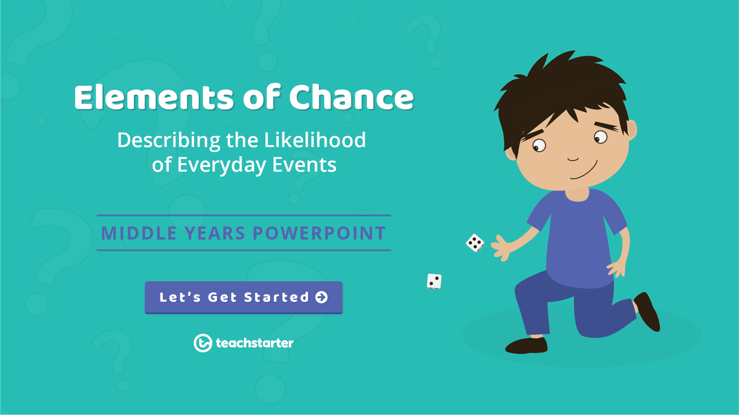

Slide 3
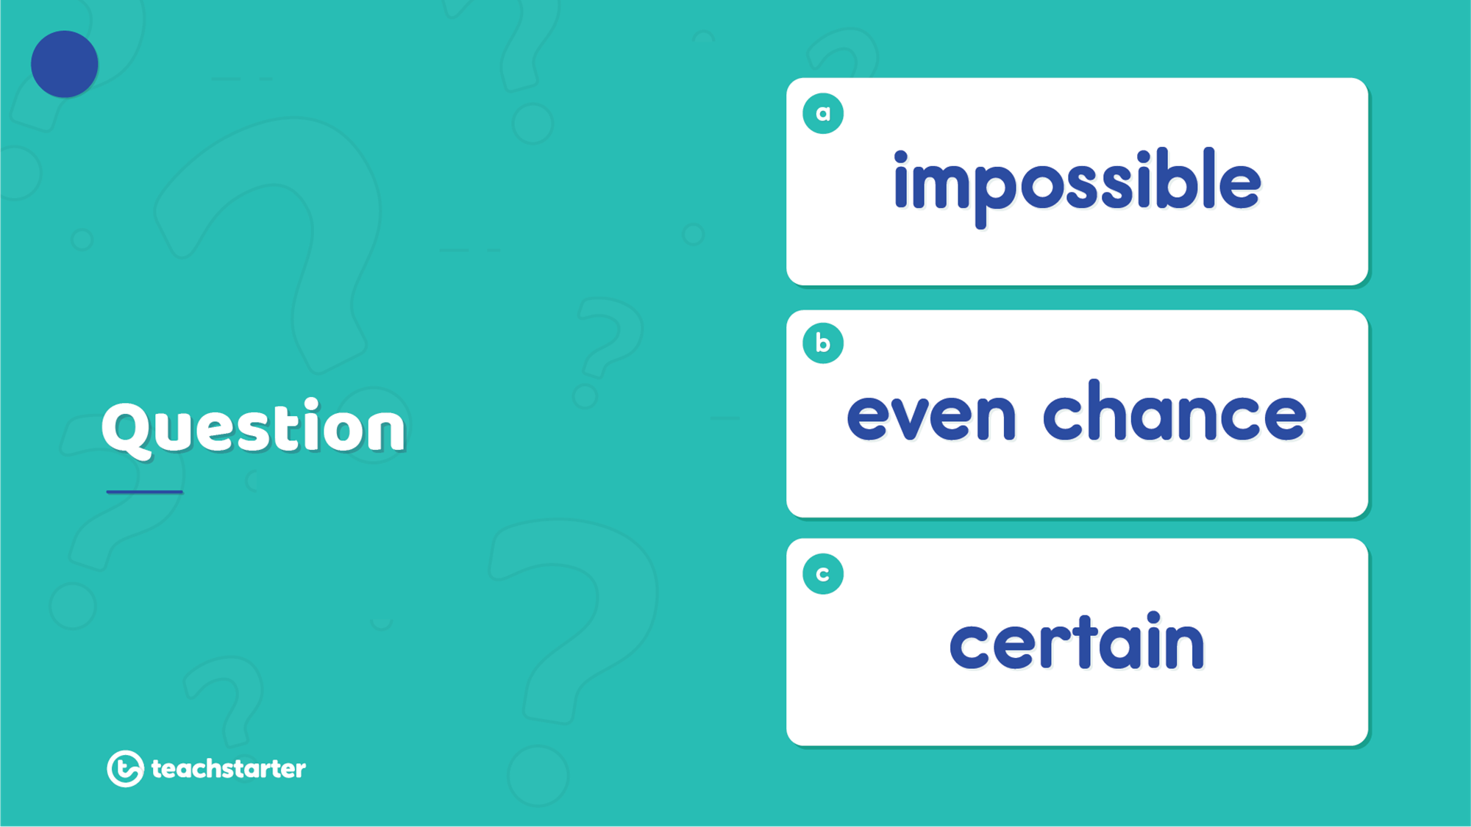
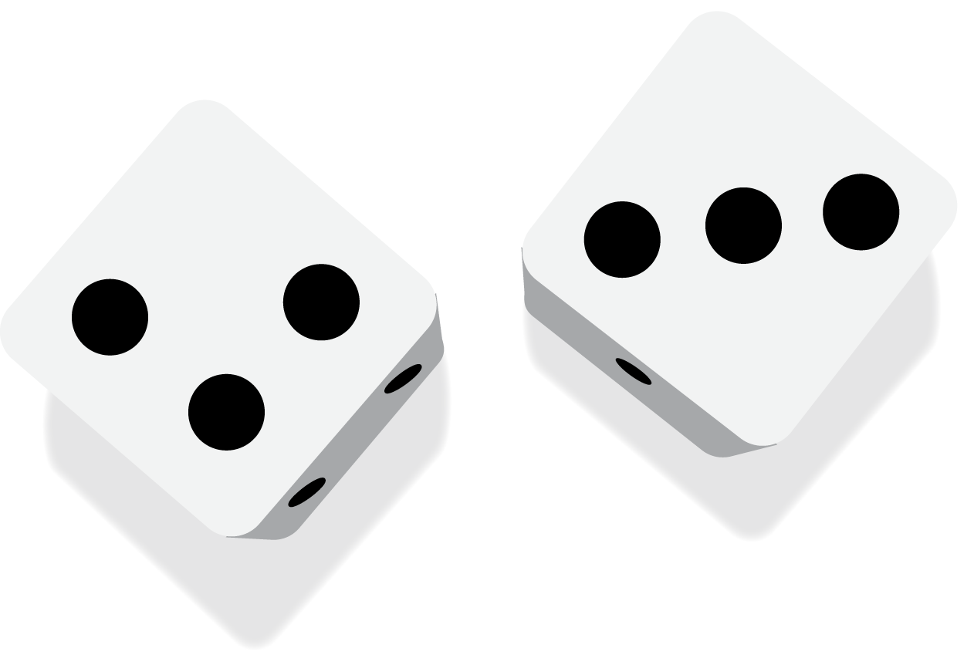
1
What is the likelihood of rolling a number greater than 3 on a 6-sided dice?

Slide 4
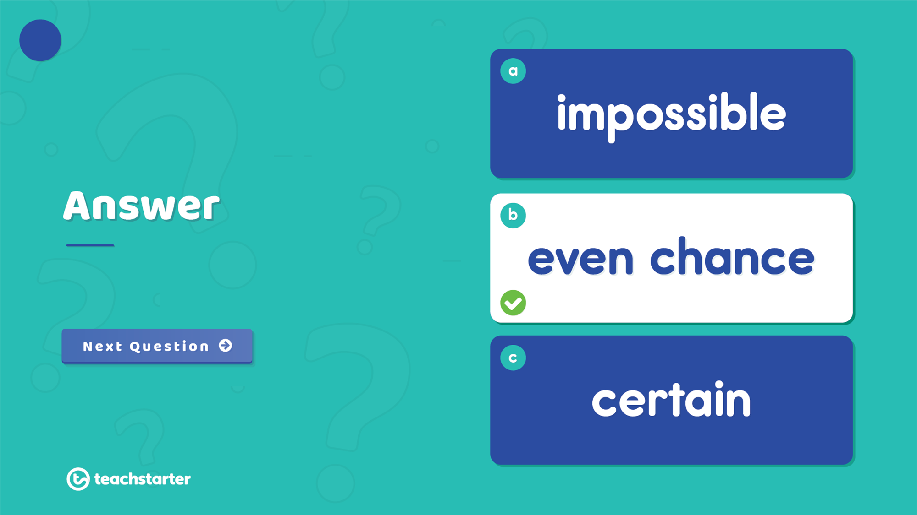
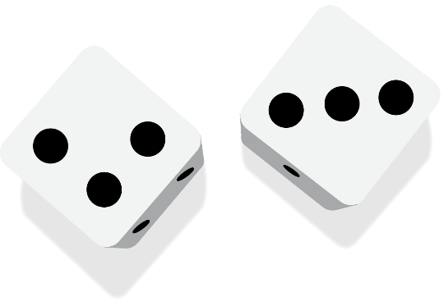
1
There is an even chance of rolling a number greater than 3 on a 6-sided dice.

Slide 5
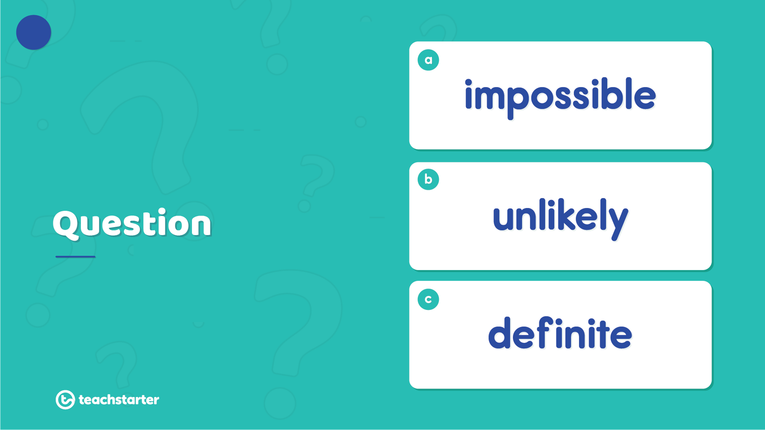
2
What is the chance of rolling a multiple of 5 on a 6-sided die?

Slide 6
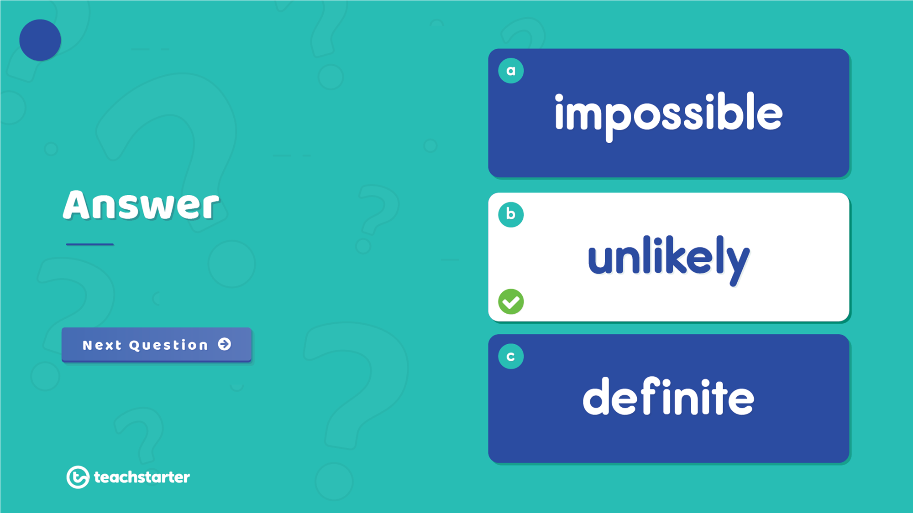
2
It is unlikely to roll a multiple of 5 on a 6-sided dice.

Slide 7
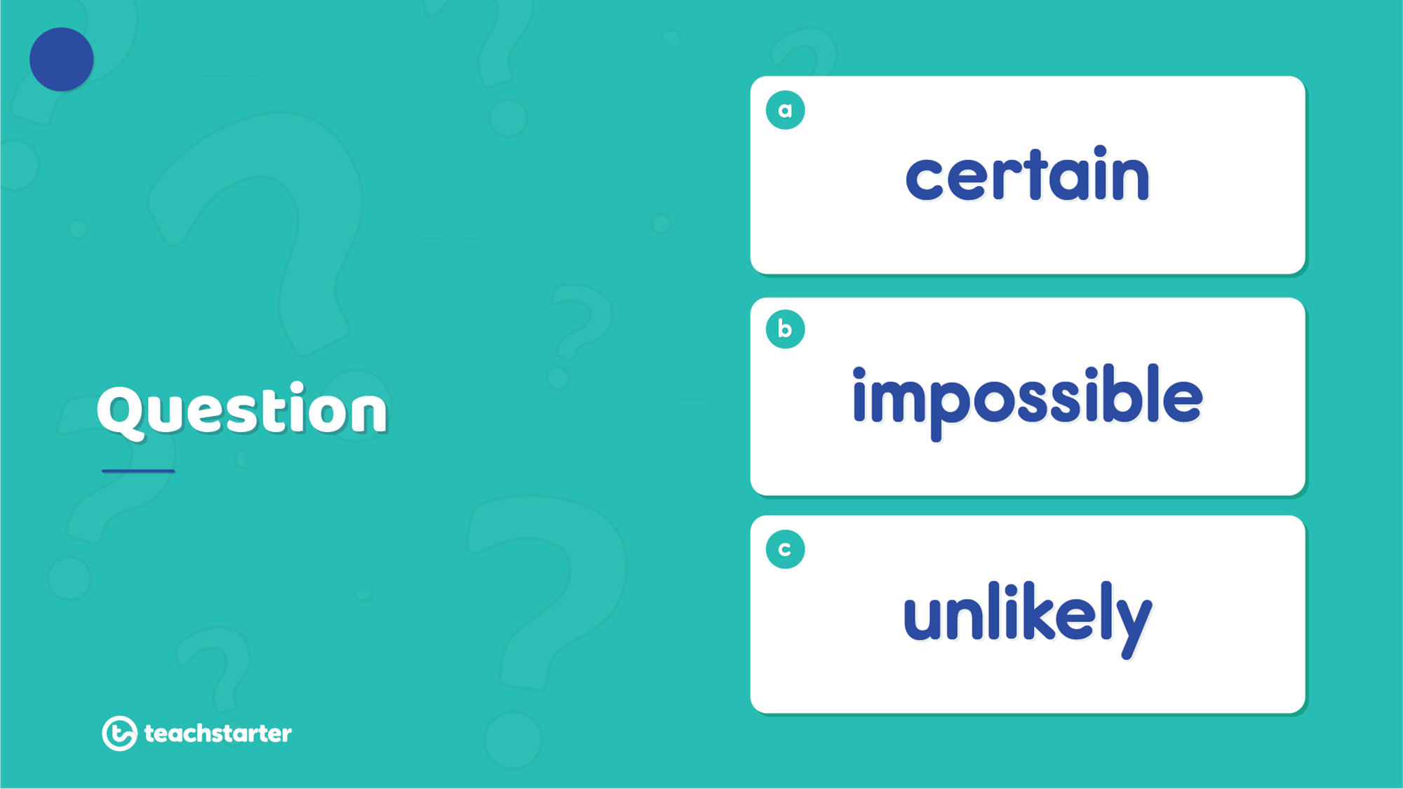

3
What is the likelihood of you purchasing a new laptop computer from a florist?

Slide 8
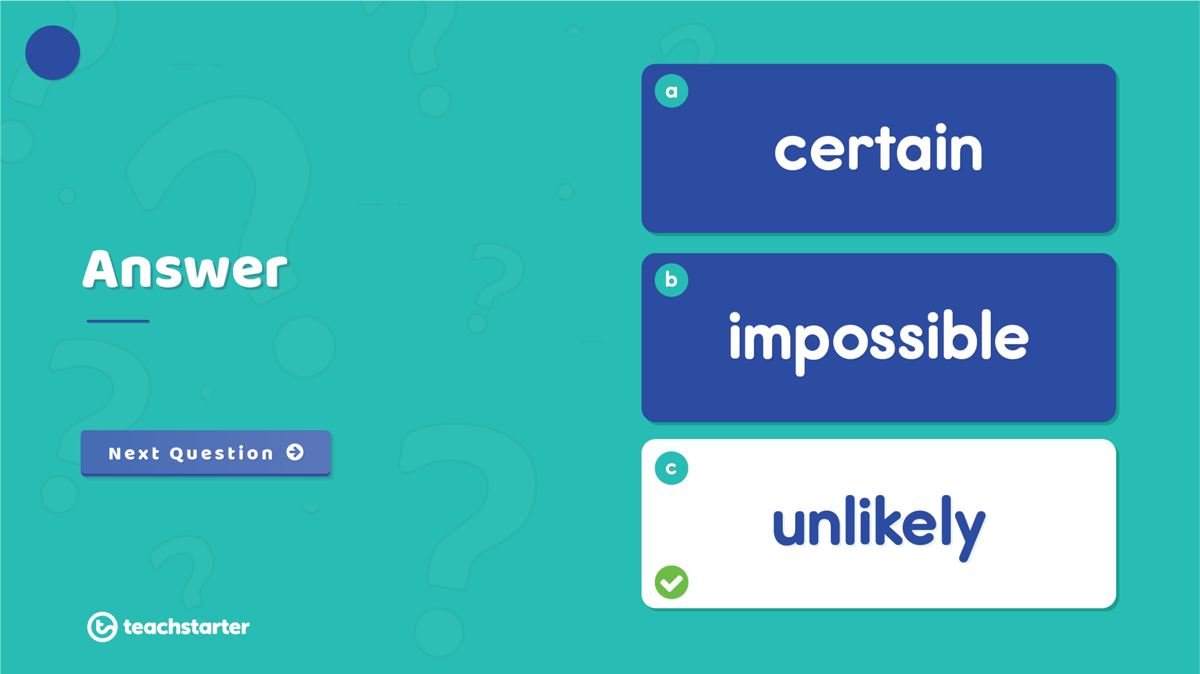
3
It is unlikely you would purchase a new laptop computer from a florist.

Slide 9
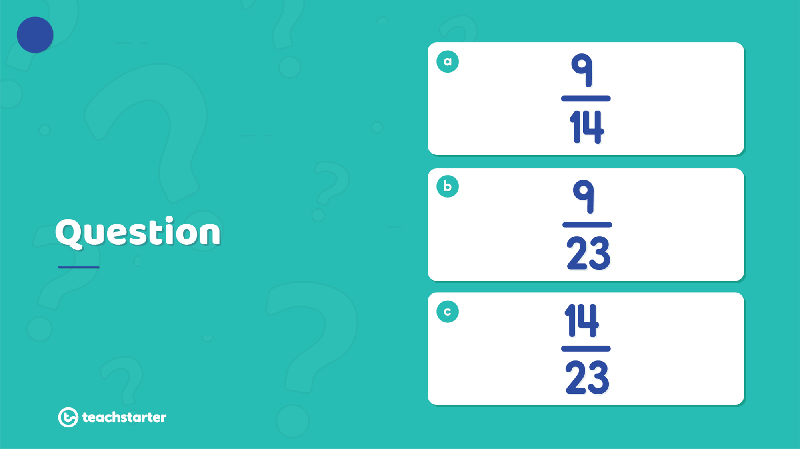



4
What is the probability of selecting a purple marble from the jar at random?

Slide 10
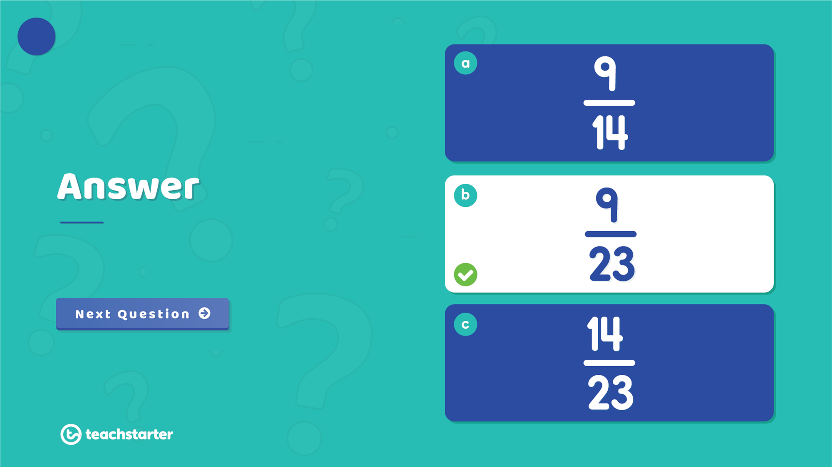



4
The probability of selecting a purple marble from the jar is $\frac{9}{23}$ .

Slide 11
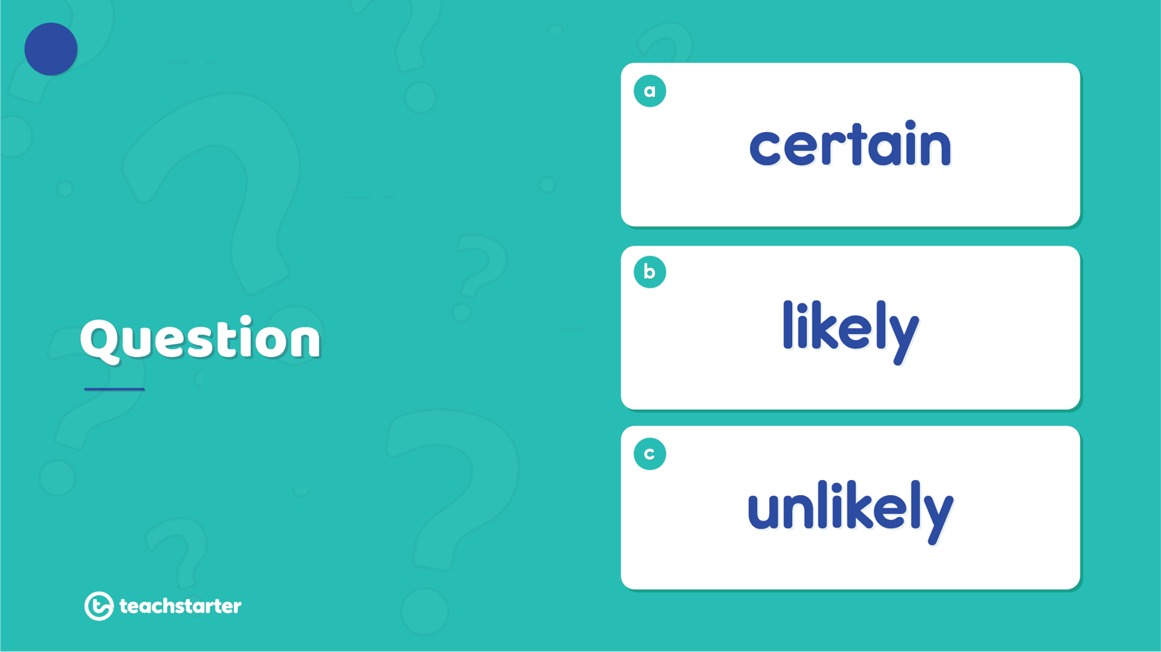

5
What is the likelihood of winning a prize in a raffle in which you purchase every ticket?

Slide 12
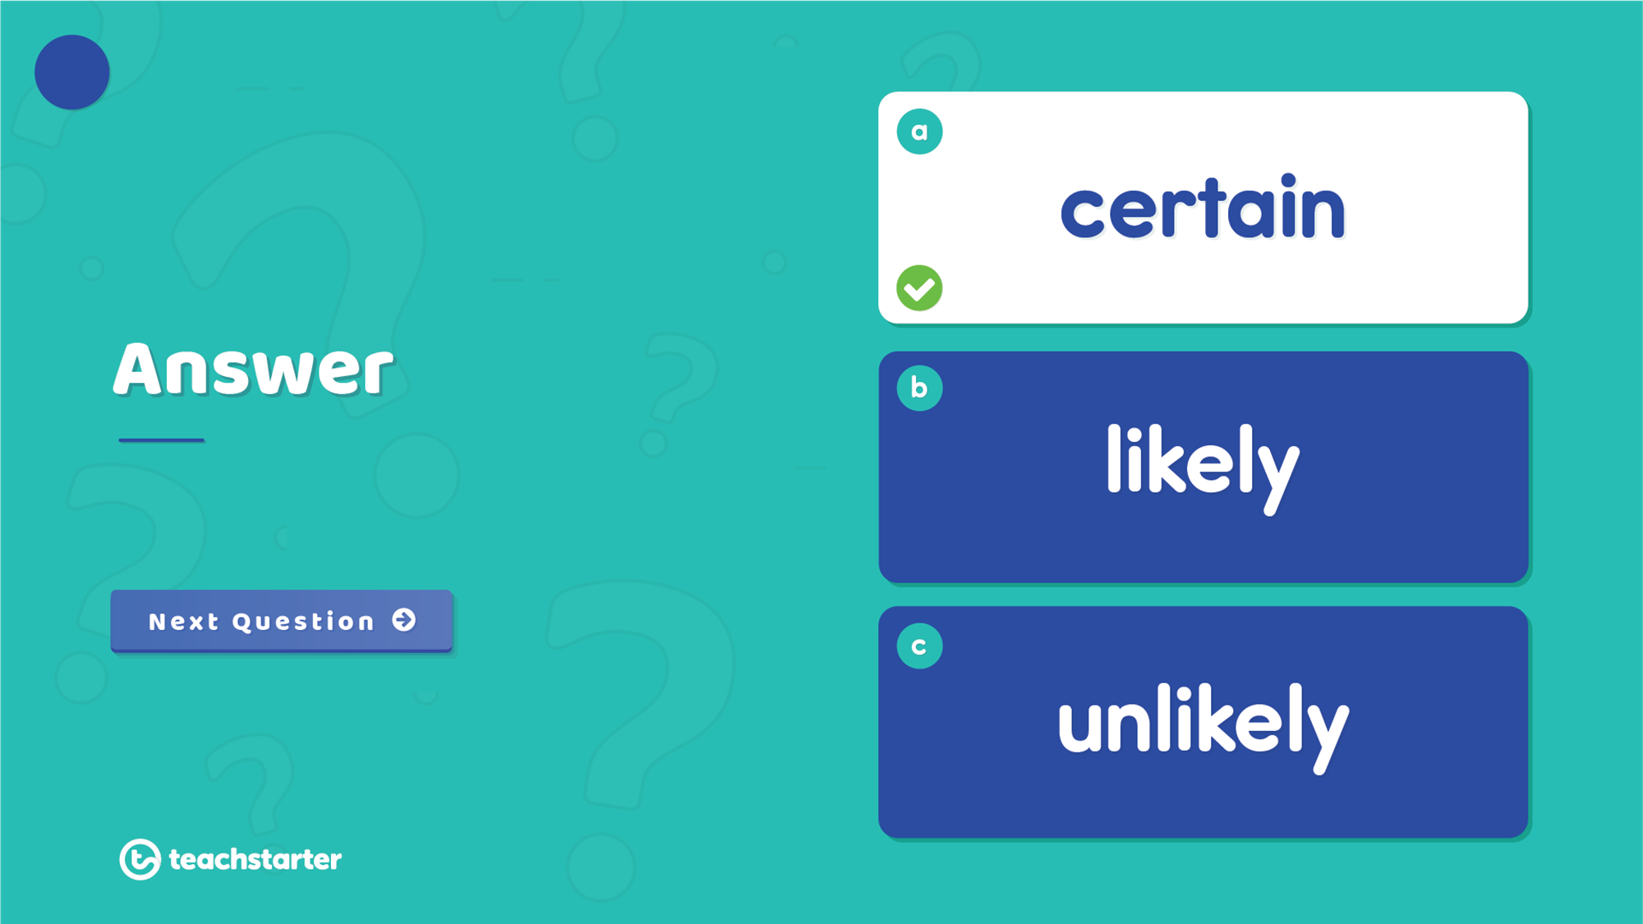
5
It is certain that you would win a prize in a raffle in which you purchase all the tickets.

Slide 13
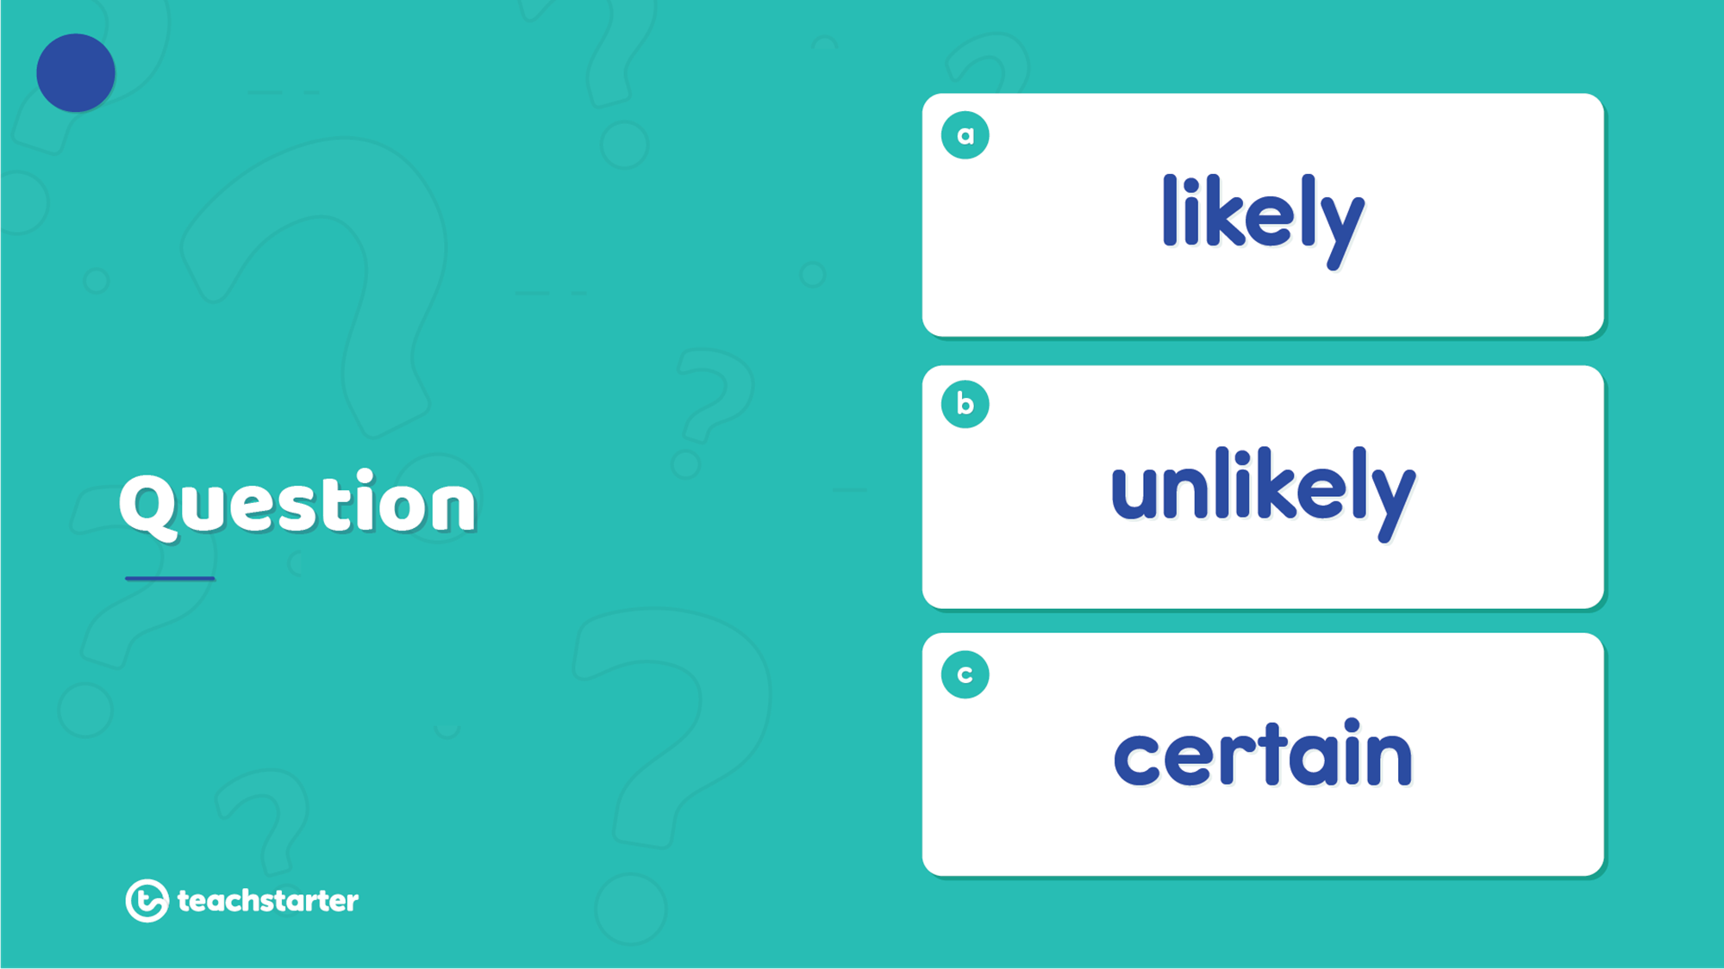
6
What is the chance of the spinner landing on the yellow section?

Slide 14
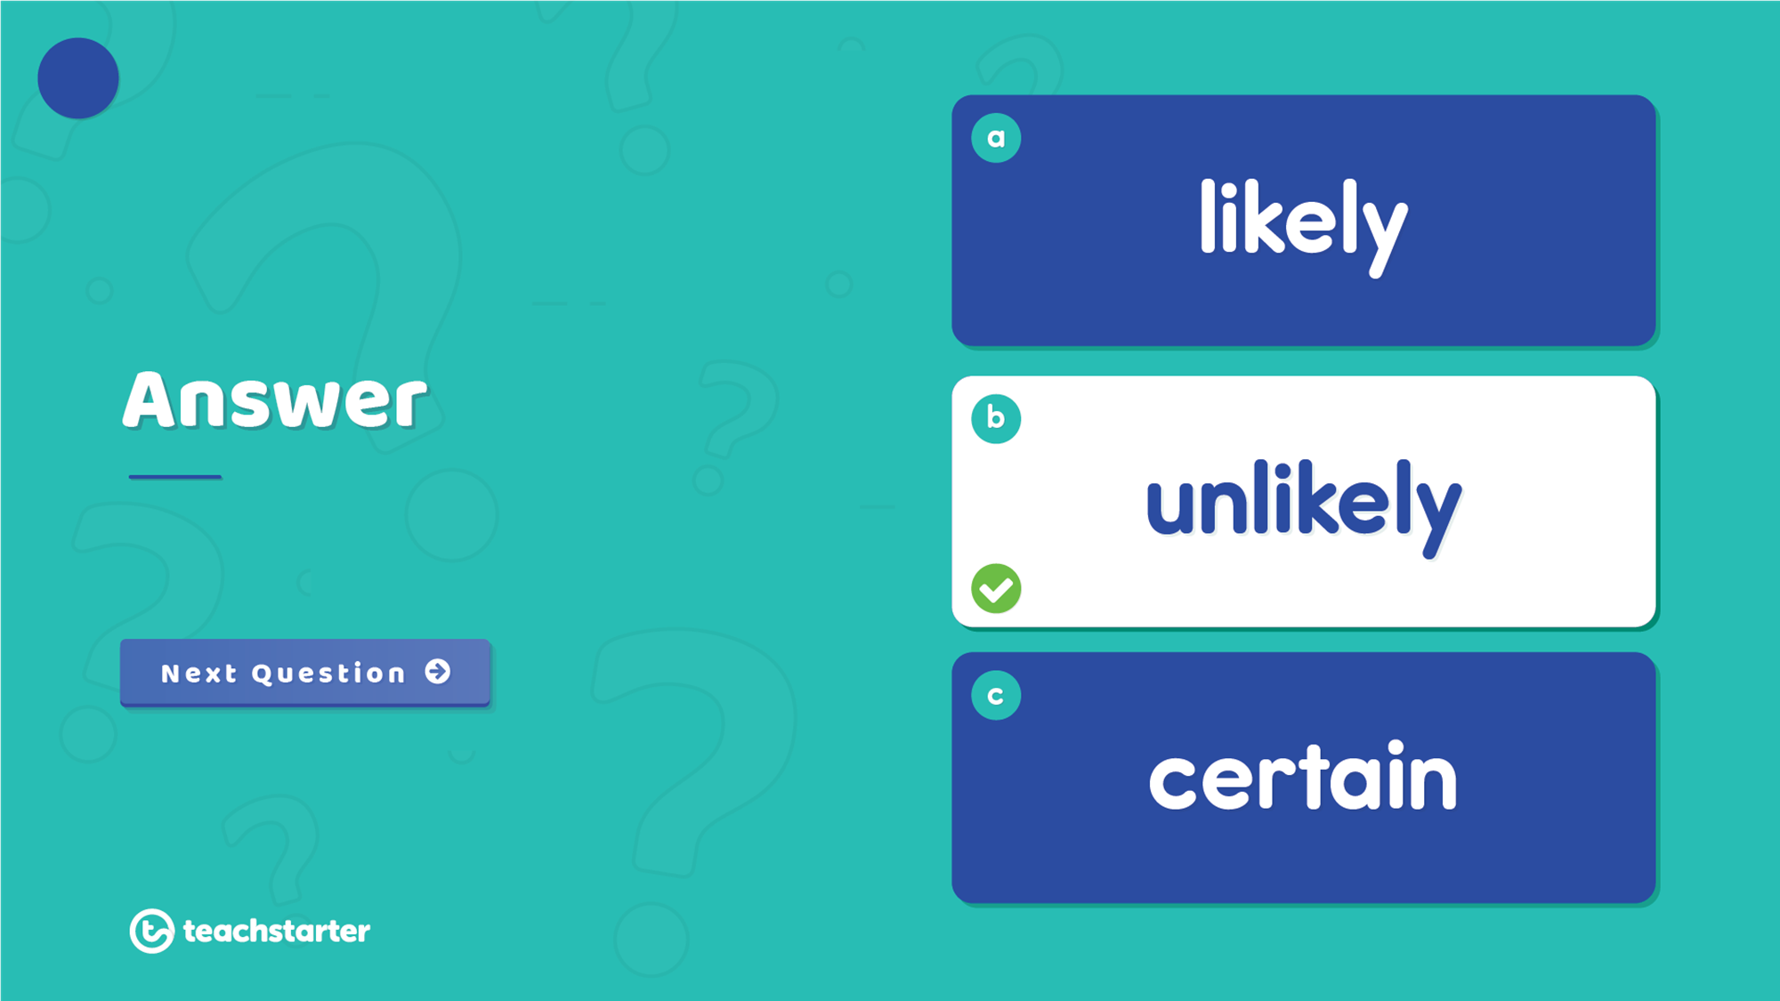
6
It is unlikely the spinner would land on yellow.

Slide 15
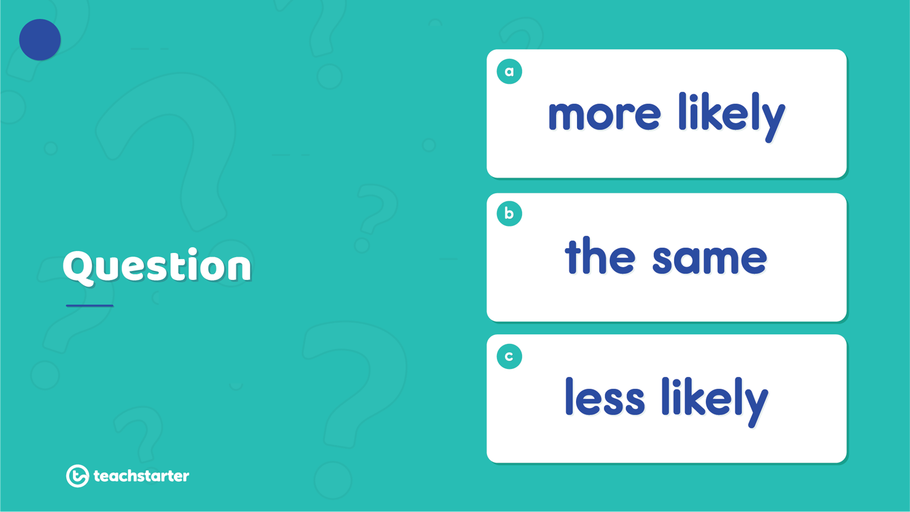
7
If I just rolled a 4 and a 3 using two dice, what are the chances of doing it again?

Slide 16
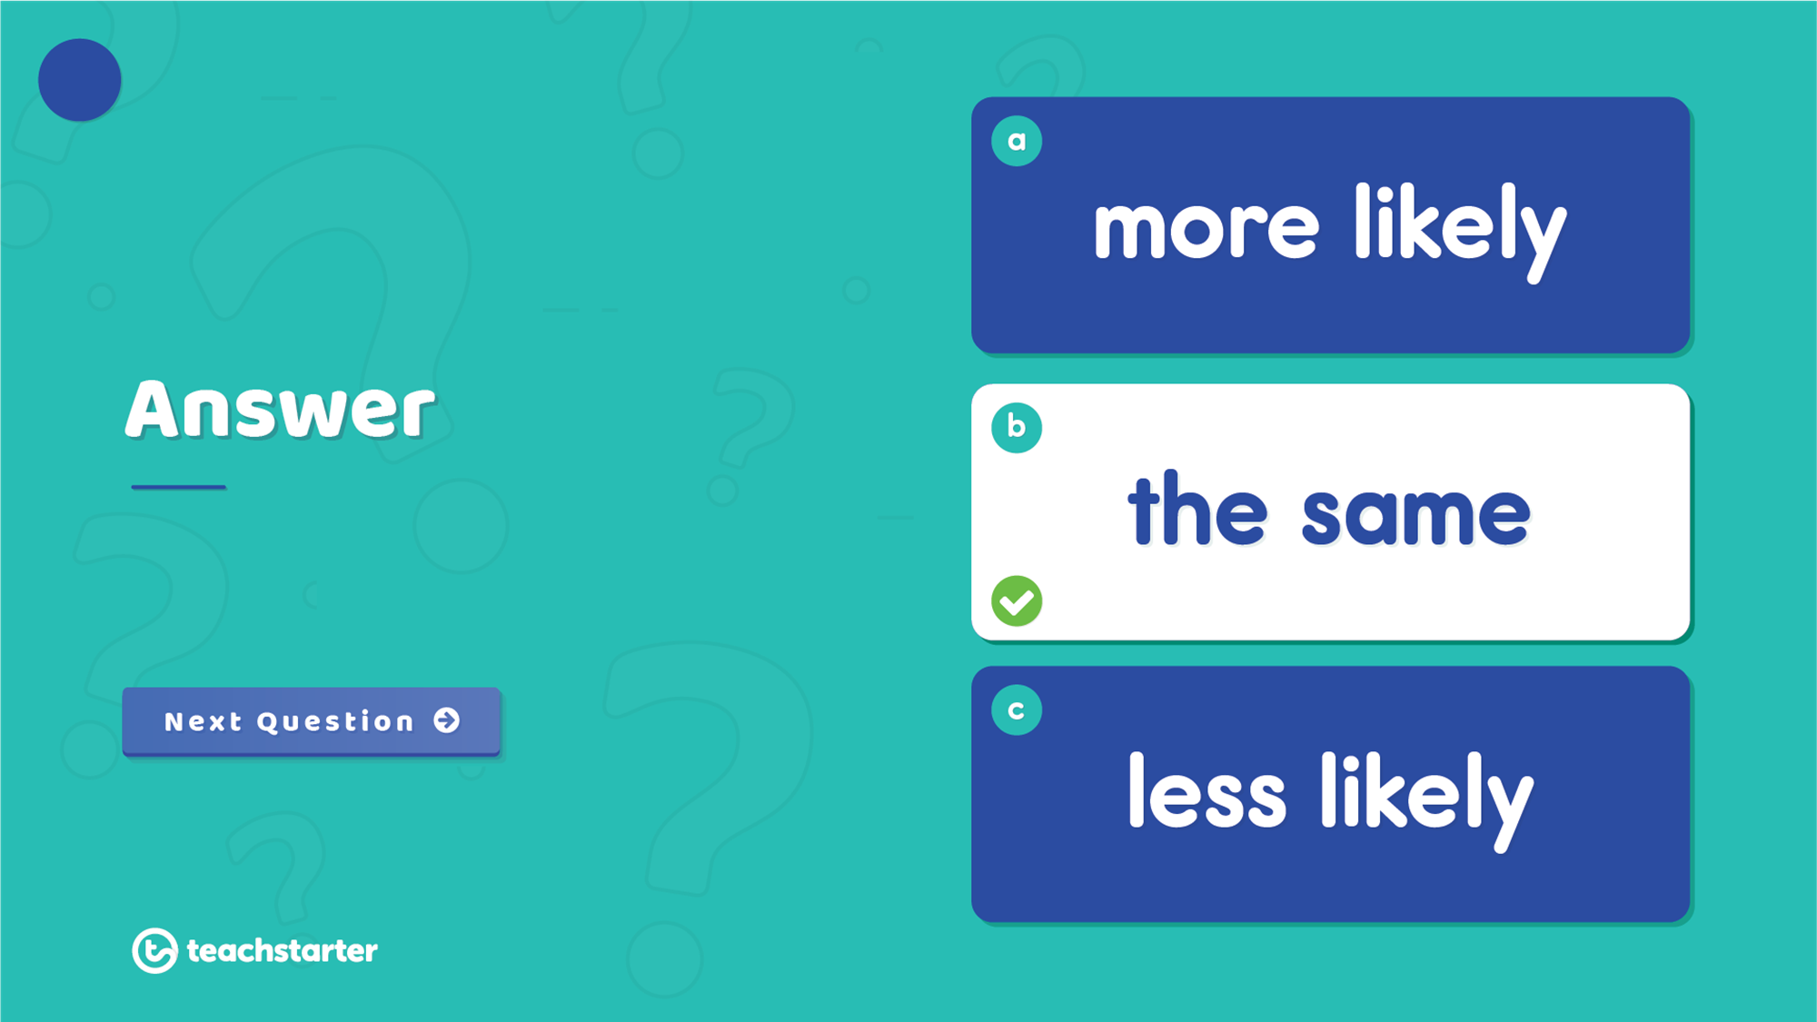
7
The chance of rolling the same numbers doesn’t change. Each roll is an independent event.

Slide 17
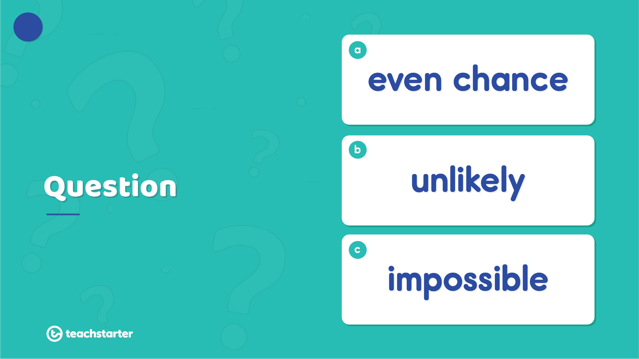
8
6
1
2
4
9
7
5
3
10
8
What is the chance of the spinner landing on an odd number?

Slide 18

8
6
1
2
4
9
7
5
3
10
8
There is an even chance of the spinner landing on an odd number.

Slide 19
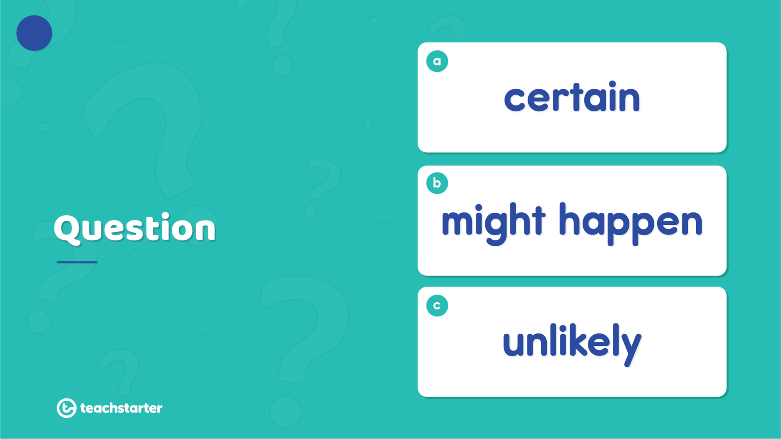

9
What is the likelihood of Monday being the day of the week that follows Sunday?

Slide 20
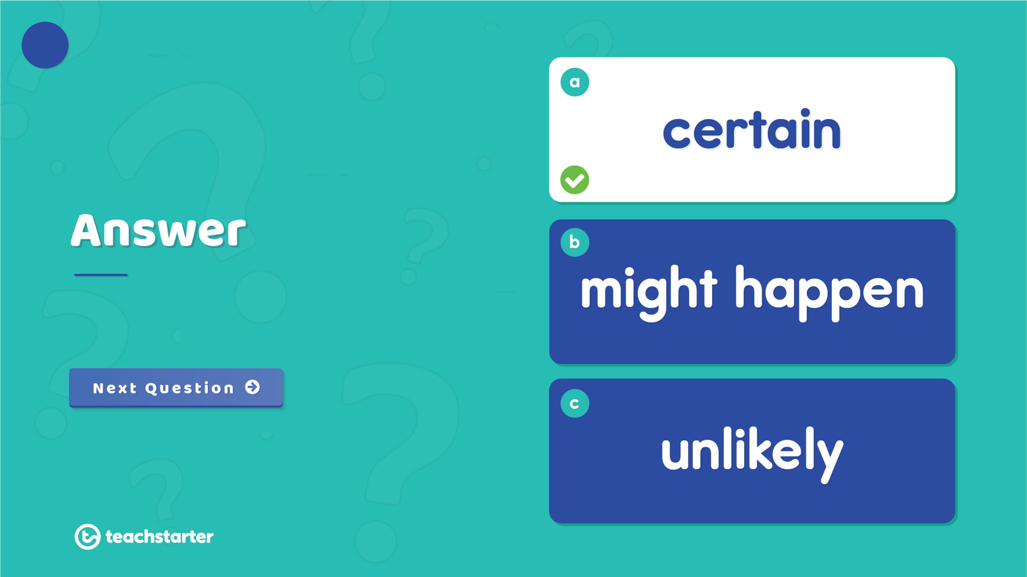
9
It is certain that Monday follows Sunday.

Slide 21
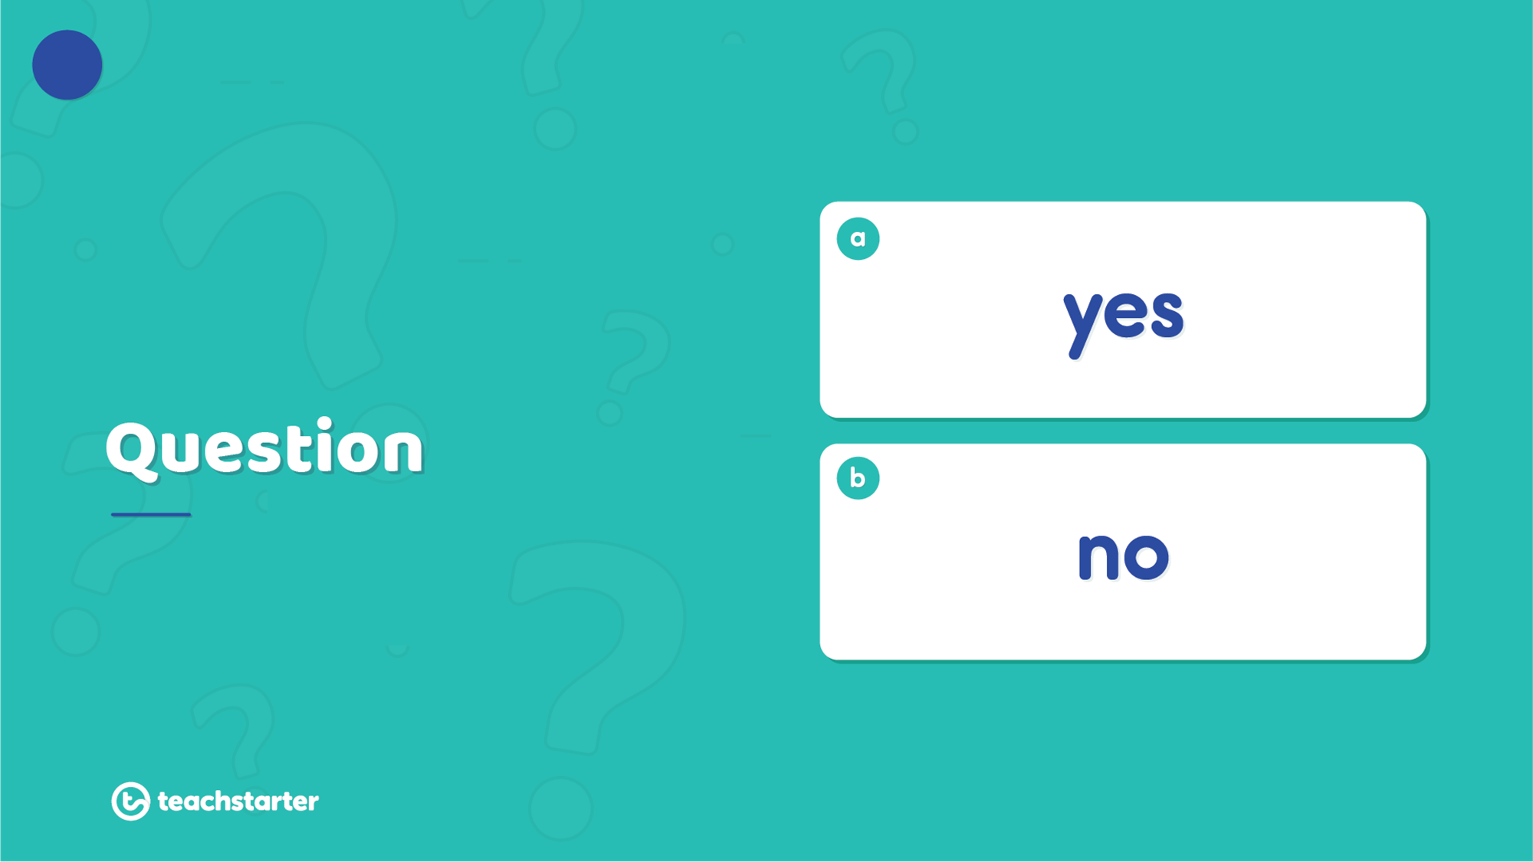


10
If a person picks a red gem out of one jar, does it change the chance of picking a red gem from the other jar?

Slide 22
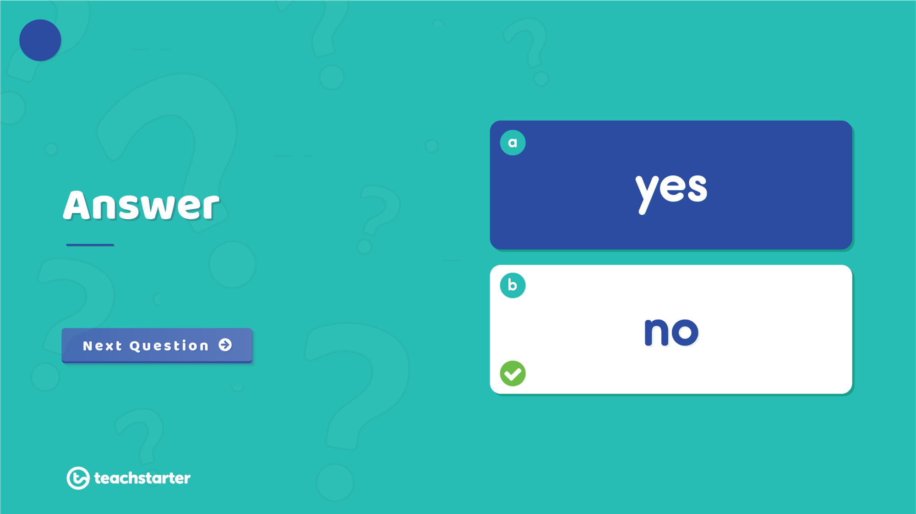


10
No. These events are independent and will not be affected by each other.

Slide 23
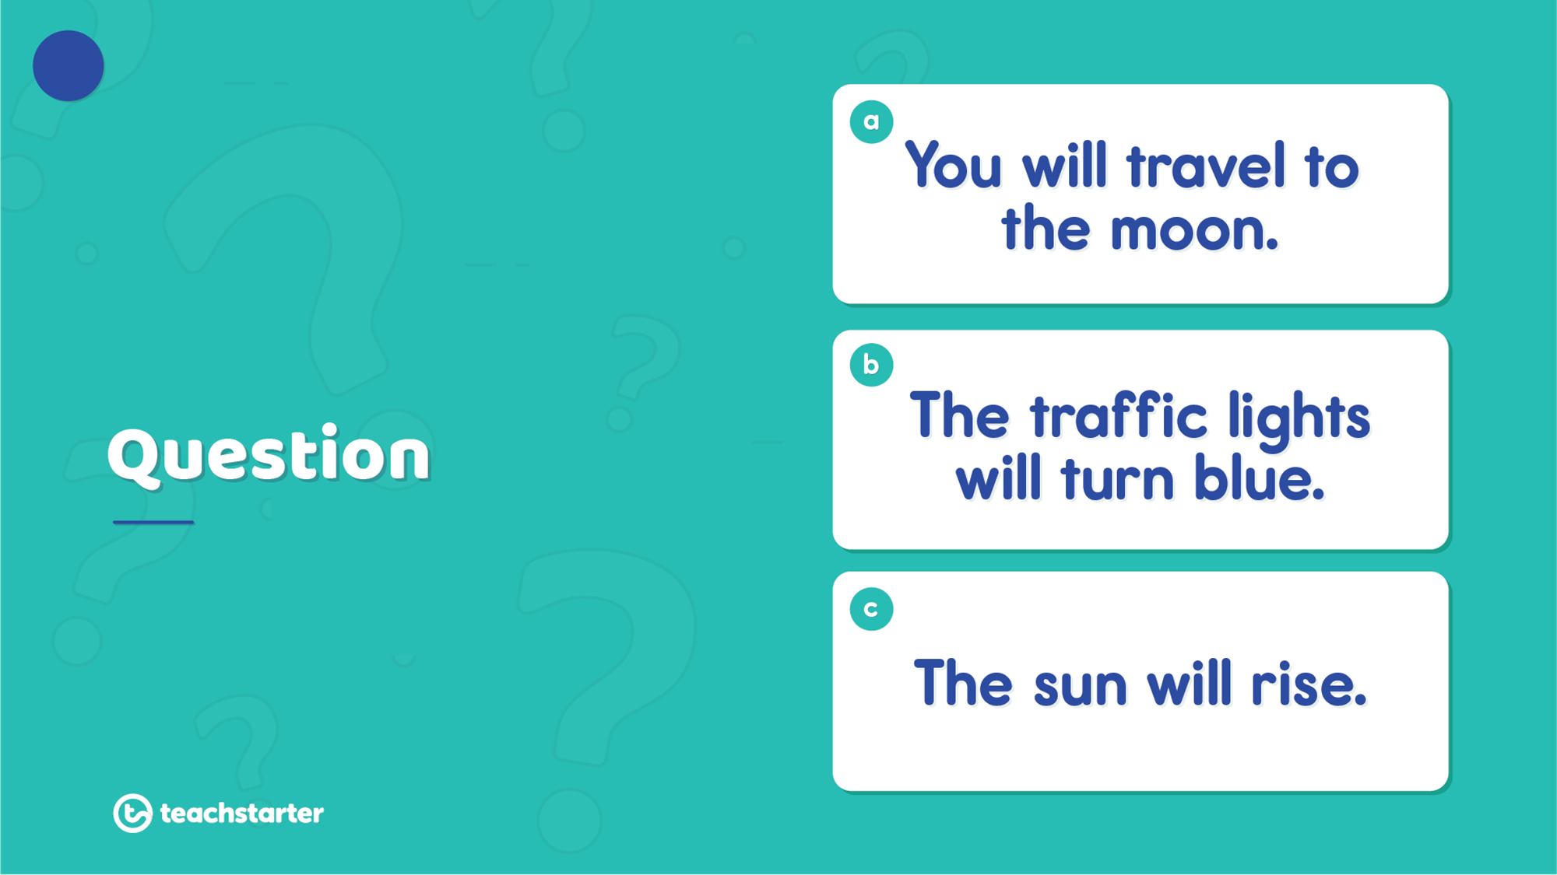



11
Which of the following is the most likely to happen?

Slide 24
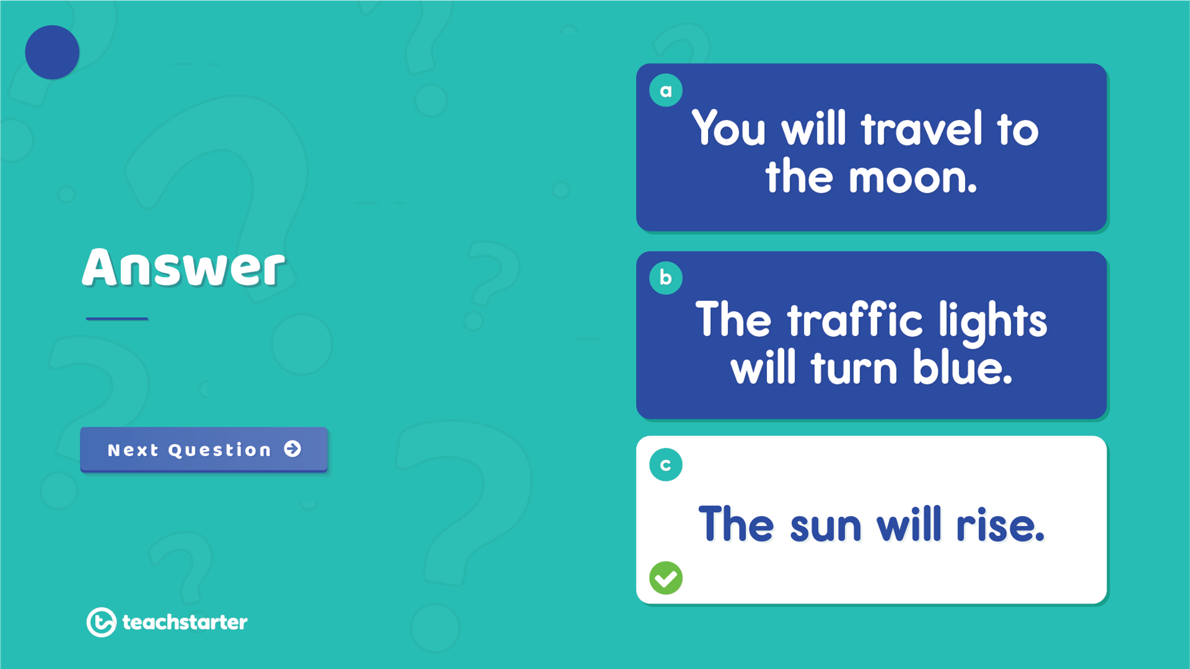



11
It is most likely that the sun will rise.

Slide 25
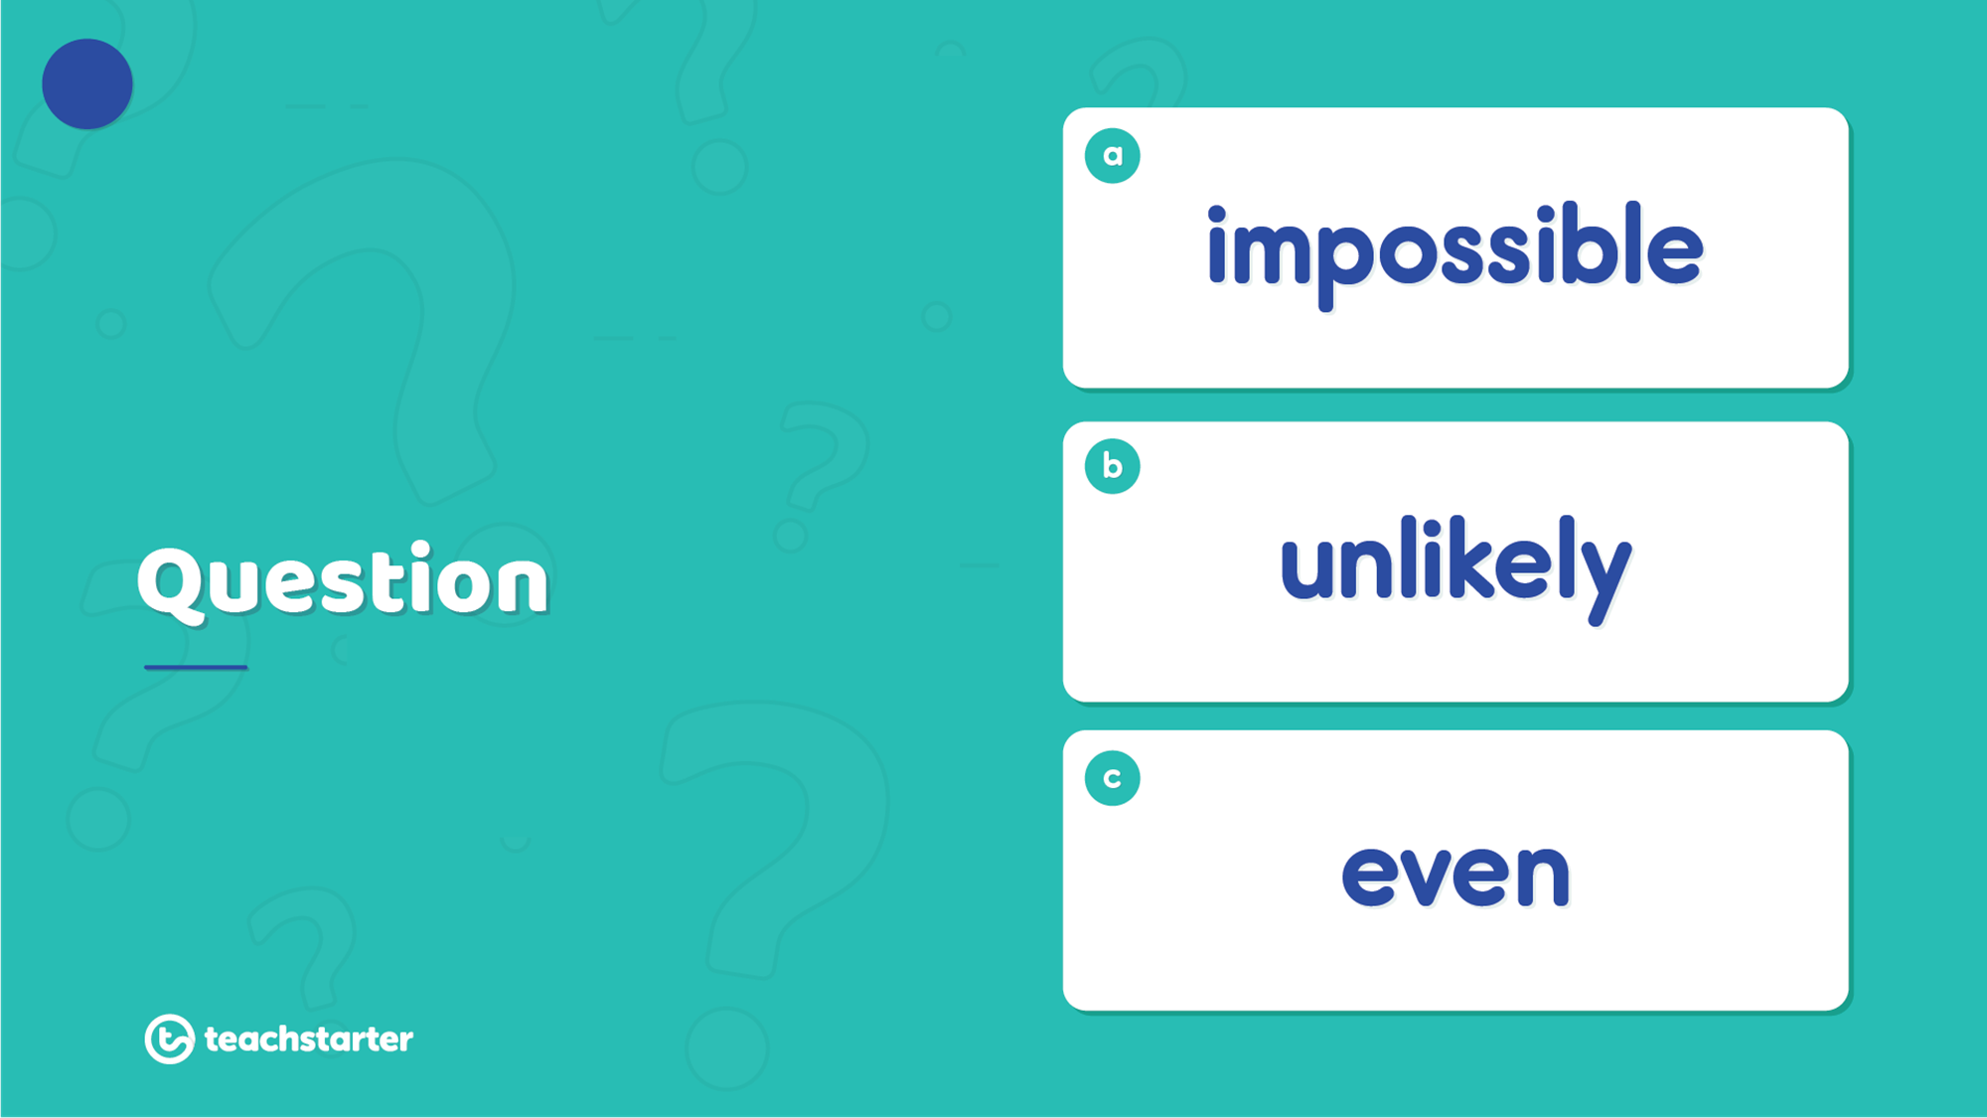
12
What is William's chance of selecting a red counter from the jar at random?

Slide 26
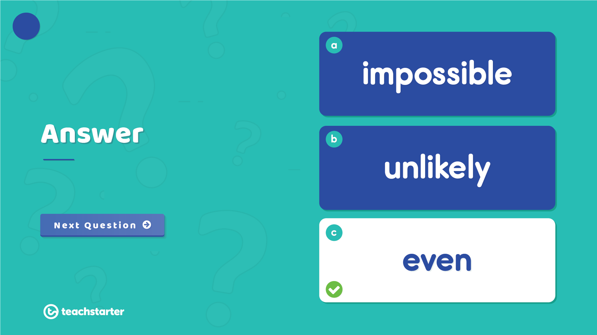
12
William has an even chance of selecting a red counter at random.

Slide 27
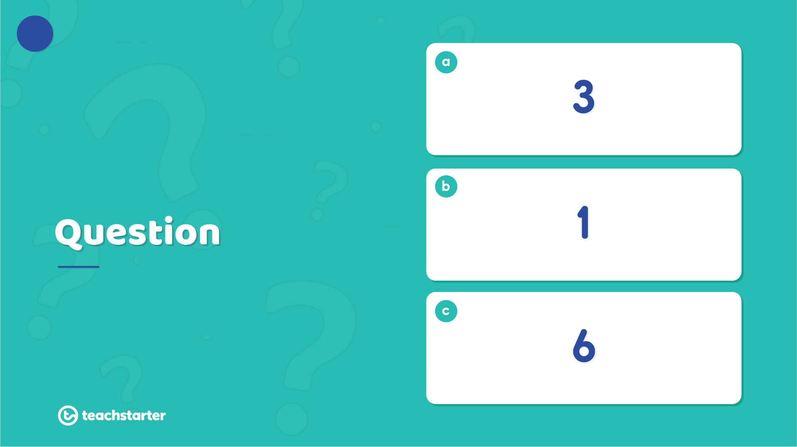
13
6
2
3
6
6
3
1
8
Which number is the spinner most likely to land on?

Slide 28
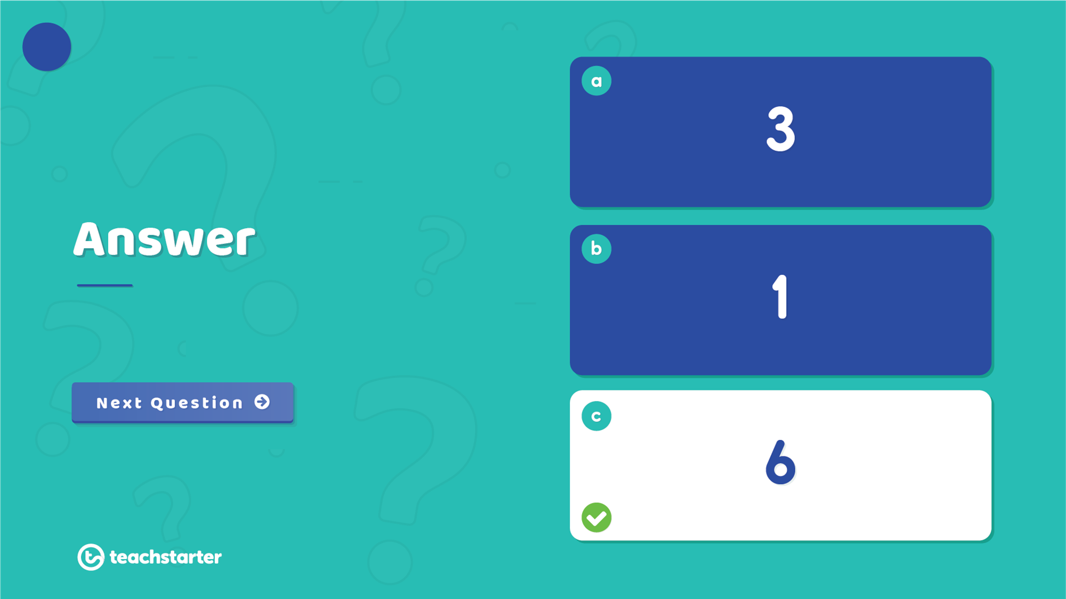
13
6
2
3
6
6
3
1
8
The spinner is most likely to land on 6.

Slide 29
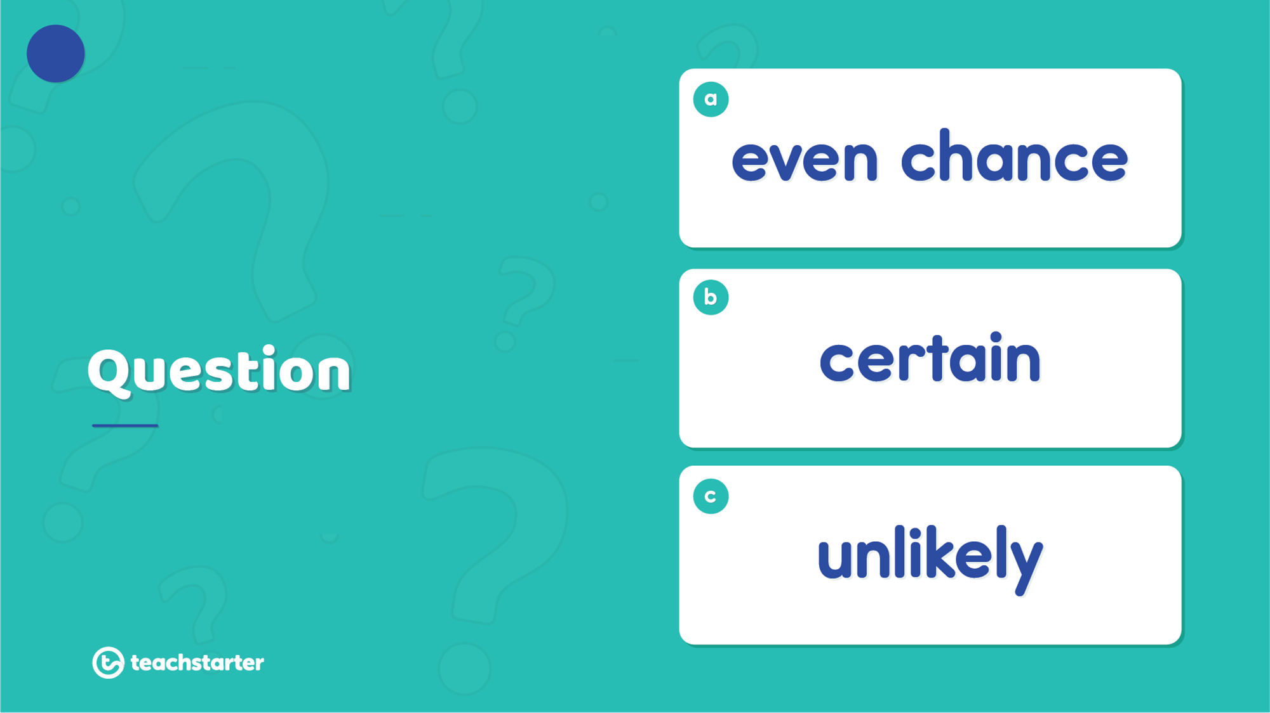
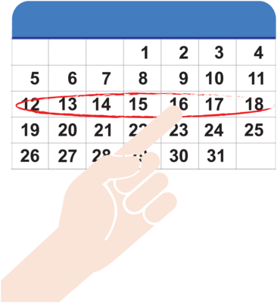
14
What is the chance of there being one Thursday in a calendar week?

Slide 30

14
It is certain that there is one Thursday in a calendar week.

Slide 31
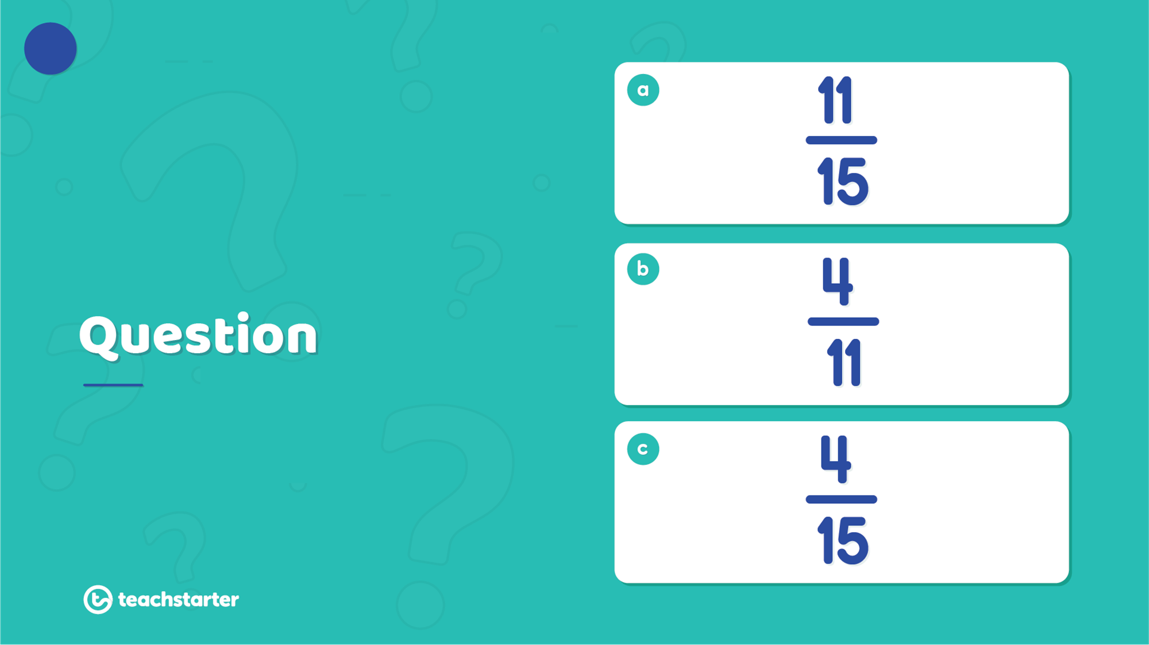
15
Aliya placed her hand in the jar and picked one shape without looking. What is the probability she selected a square?

Slide 32
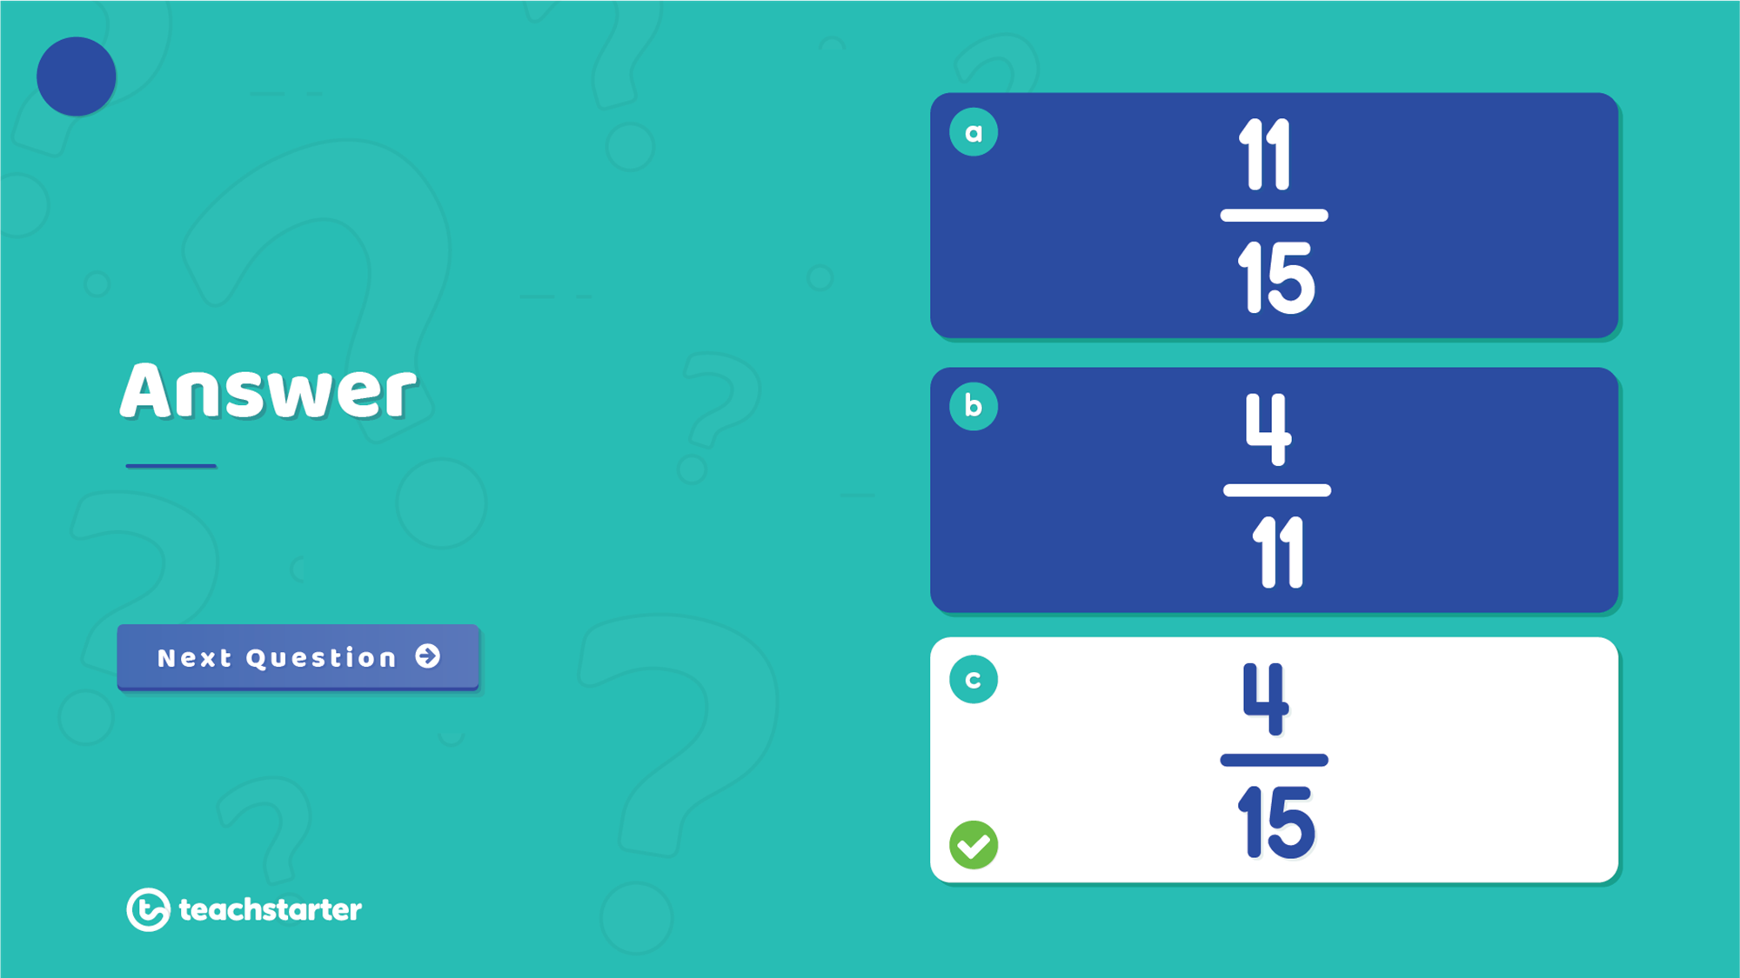

15
The probability of selecting a square at random is $\frac{4}{15}$ .

Slide 33
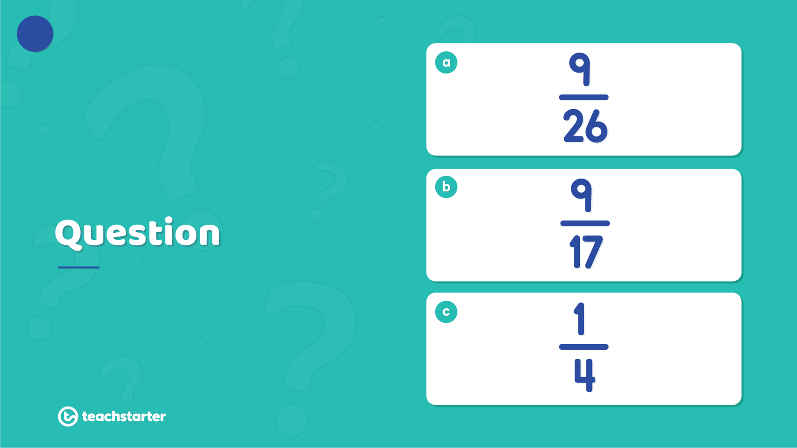
16
Eyes | Number of students
Blue | 9
Hazel | 3
Green | 8
Brown | 6
What is the probability that a child with blue eyes is chosen at random?

Slide 34
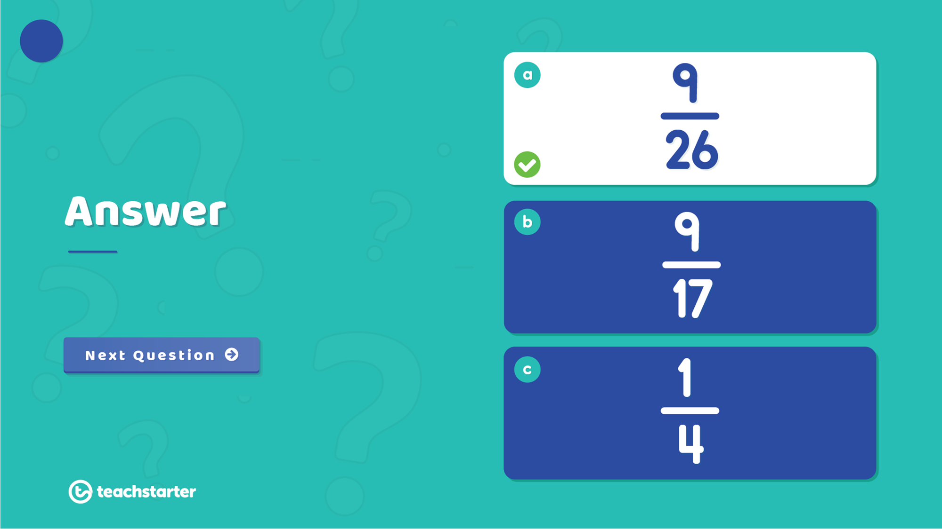

16
Eyes | Number of students
Blue | 9
Hazel | 3
Green | 8
Brown | 6
The probability of a child with blue eyes being selected is $\frac{9}{26}$ .

Slide 35


17
Troy randomly picked a lolly out of the jar and it was pink. If he picked another lolly, what are the chances of him getting a pink one again?

Slide 36
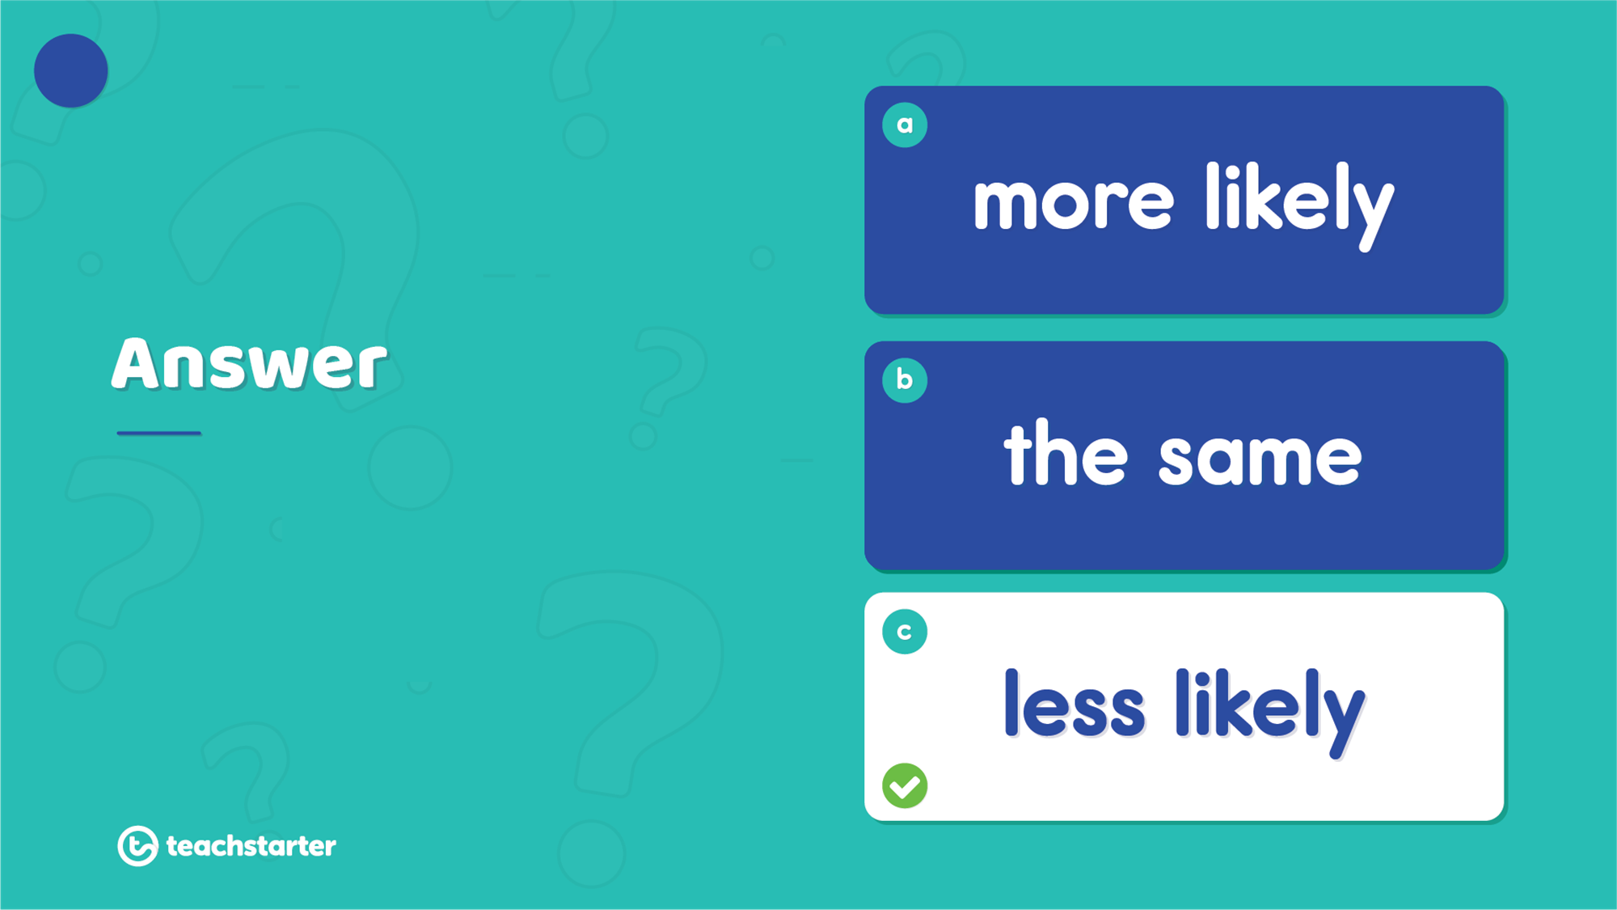



17
The chances are less likely. These are dependent events. Choosing from the same jar changes the probability from $\frac{4}{8}$ to $\frac{3}{7}$ .

