Slide 1
Teacher Notes

Slide 3
Symbols
I do: my turn to talk. This is the explanation section of our lesson where you are required to listen.
We do: this is where we discuss or work on the concepts together.
You do: your turn to be involved. You may be working in a group or on an activity individually.

Slide 5

What Are Informative Texts?
Informative texts provide factual information about a particular topic.
Some examples of topics include people, animals, objects and events.
There are many types of informative texts, such as:
procedures
reports
explanations
news articles.

Slide 6
Informative Texts - Structure
Title | This is the main idea of the text.
Introduction | This is a general statement about the subject of the text. It may also classify the subject as a part of a particular group.
Description | This is a series of factual paragraphs about the subject. These should describe the subject’s characteristics.
Conclusion | This is a concluding statement about the subject of the text. It may also summarise the key features of the subject.

Slide 7
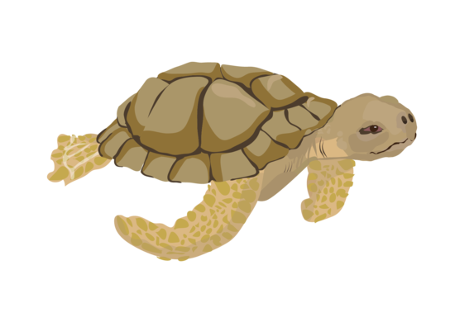
Informative Text Example – Turtles
Introduction
Turtles are reptiles. They are cold-blooded, so they need sunlight to keep them warm and active.
Description
Turtles have a hard shell on their back. This protects them from their enemies. Some turtles can even hide their heads inside their shells if they are being attacked!

Slide 8
Informative Text Example – Turtles
Turtles lay their eggs on land. Some turtles lay their eggs in sand, then leave the eggs to hatch on their own. When they hatch, the baby turtles scramble down into the water. They have to be quick so that they don’t get eaten by larger animals.
Most turtles eat plants that grow in the water. Some turtles also like to eat meat. These turtles eat small insects, snails and worms.
Conclusion
Many species of turtles are endangered, which means they are at risk of extinction. Humans must work to protect these beautiful creatures.

Slide 9

Informative Text Structure – Class Activity
As a class, read the informative text, Owls. The text can be found on the next two slides.
As you are reading, work together as a class to identify the informative structure of the text, including:
the title
the introduction
the description
the conclusion.

Slide 10
Informative Text Structure – Example
Owls
Owls are known as birds of prey. They are nocturnal, which means they sleep during the day and hunt at night.
Owls have forward-facing eyes and a hooded beak. As they do not have teeth, they use their sharp beak to help them tear apart their food. They also have powerful claws which help them to catch their prey. The colour of an owl’s feathers can be brown, grey, white and black. The mix of colours provides a nice camouflage for the owl in their environment.

Slide 11

Informative Text Structure – Example
Owls are carnivores, which means that they eat meat. They hunt insects, small mammals and other small birds during the night.
Owls most commonly lay between three and four eggs. They are white and round. The eggs do not hatch at the same time. The life span of an owl is approximately twenty years.
There are more than 200 different species of owls. Owls can be found all over the world, except in Antarctica.

Slide 12
Informative Text Structure – Answers
Did your class manage to correctly label the structure of the text?
Title – Owls
Introduction – Owls are nocturnal birds of prey.
Description – Owls have forward-facing eyes, a hooded beak and powerful claws. The colour of an owl’s feathers can be brown, grey, white and black. Owls are carnivores. They lay between three and four eggs and live for approximately twenty years.
Conclusion – There are more than 200 different species of owls. Owls can be found all over the world, except in Antarctica.

Slide 13


Informative Text Structure – Review
Use your knowledge of informative text structure to unjumble and correctly sequence the following texts.
Sequencing Activity – Roald Dahl
Sequencing Activity – Tyrannosaurus Rex
Sequencing Activity - Thunderstorms

Slide 14

Informative Texts – Language
Informative texts use factual, subject-specific language.
Here are some examples of the language and grammatical features you might find in an informative text:
subject-specific, technical vocabulary
group and/or category words
adjectives and adverbs
connectives of time
phrases showing cause and effect
comparative language.

Slide 15

Informative Language – Examples
Subject-specific vocabulary
E.g. Polar bears are warm-blooded.
Groups and/or categories
E.g. Polar bears are mammals.
Adjectives and adverbs
E.g. Polar bears have strong paws.

Slide 16
Informative Language – Examples
Connectives of time
E.g. After the mother leaves her cubs, siblings sometimes stay together.
Cause and effect
E.g. Because of the cold climate they live in, polar bears are covered in fur.
Language of comparison
E.g. Polar bears are even larger than grizzly (brown) bears.

Slide 17
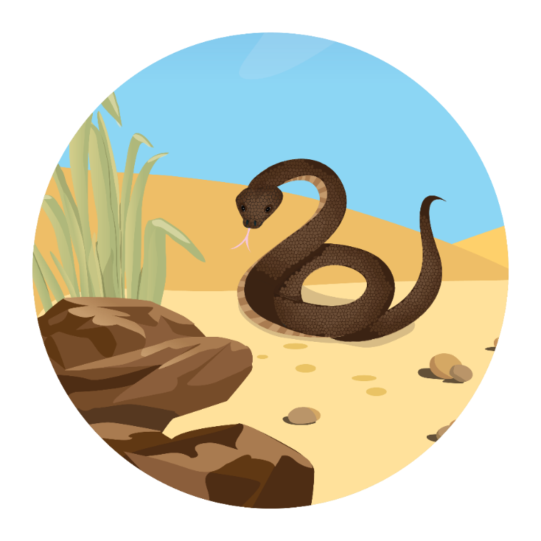
Informative Language – Pair Activity
Work with a partner. Brainstorm some words that you might find in an informative text about snakes. Make a list of your words. Think about…
subject-specific words
connectives of time
groups and categories
cause and effect
adjectives and adverbs
language of comparison

Slide 18
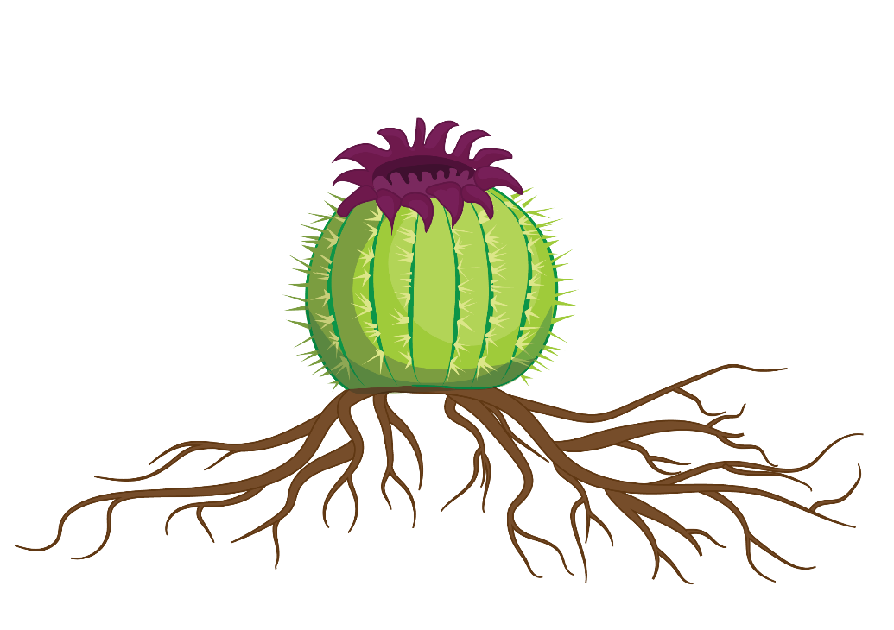
Informative Language – Review
Read this informative paragraph. In your workbook, make a list of the subject-specific vocabulary, adjectives and cause and effect phrases.
A cactus is an unusual plant called a succulent. Succulents are usually found in hot, dry climates. Because rain is so infrequent, cacti have a thick, fleshy body to store water. They also have sharp spines that collect moisture from the air. To make water collection easier, cacti have a widespread root system.

Slide 19
Review – Suggested Answers
Did you manage to find the subject-specific vocabulary, adjectives and cause and effect phrases?
A cactus is an unusual plant called a succulent. Succulents are usually found in hot, dry climates. Because rain is so infrequent, cacti have a thick, fleshy body to store water. They also have sharp spines that collect moisture from the air. To make water collection easier, cacti have a widespread root system.

