Slide 1


Who scared the black cat?

Slide 2
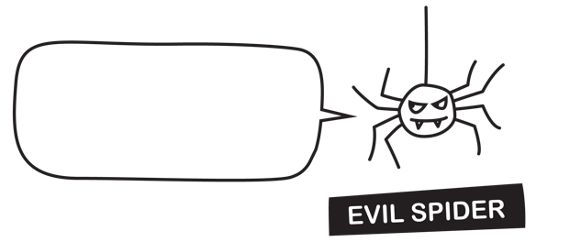

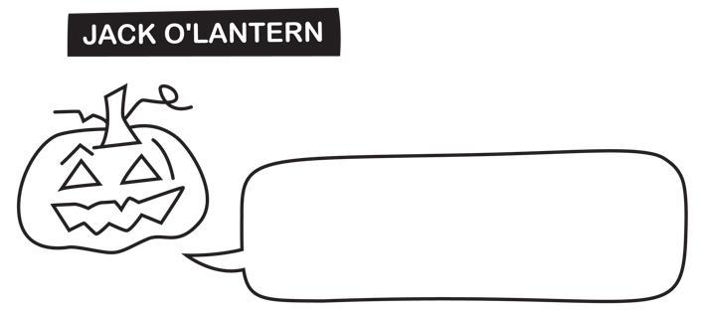

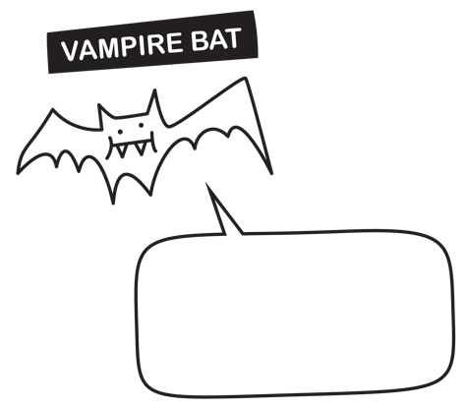

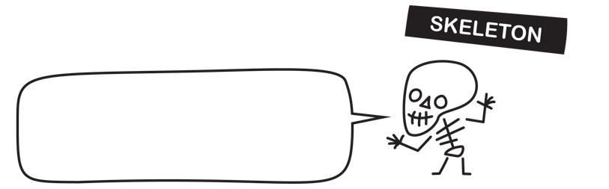




Who scared the black cat?
I was terrified!
I find the pumpkin very scary. The vampire bat has never scared anyone ever.
Fact: The cat and the spider are unaware of each other’s existence.
Fact: Everyone is telling the truth.
I tried to scare the cat but I couldn't. The skeleton is scarier than me. We are both scary but are 100% germ-free.
I would never want to scare the cat. I gave the cat a chocolate coin. The cat is terrified of spiders.
The vampire bat loves baths and hand sanitiser. I saw the clown find a coin in the rubbish bin.
The cat has never been afraid of the skeleton. The cat is afraid of germs.

Slide 3







I tried to scare the cat but I couldn't. The skeleton is scarier than me. We are both scary but are 100% germ-free.

Slide 4

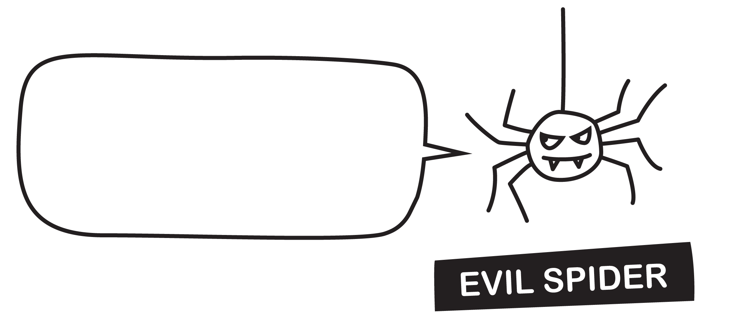

I find the pumpkin very scary. The vampire bat has never scared anyone ever.

Slide 5
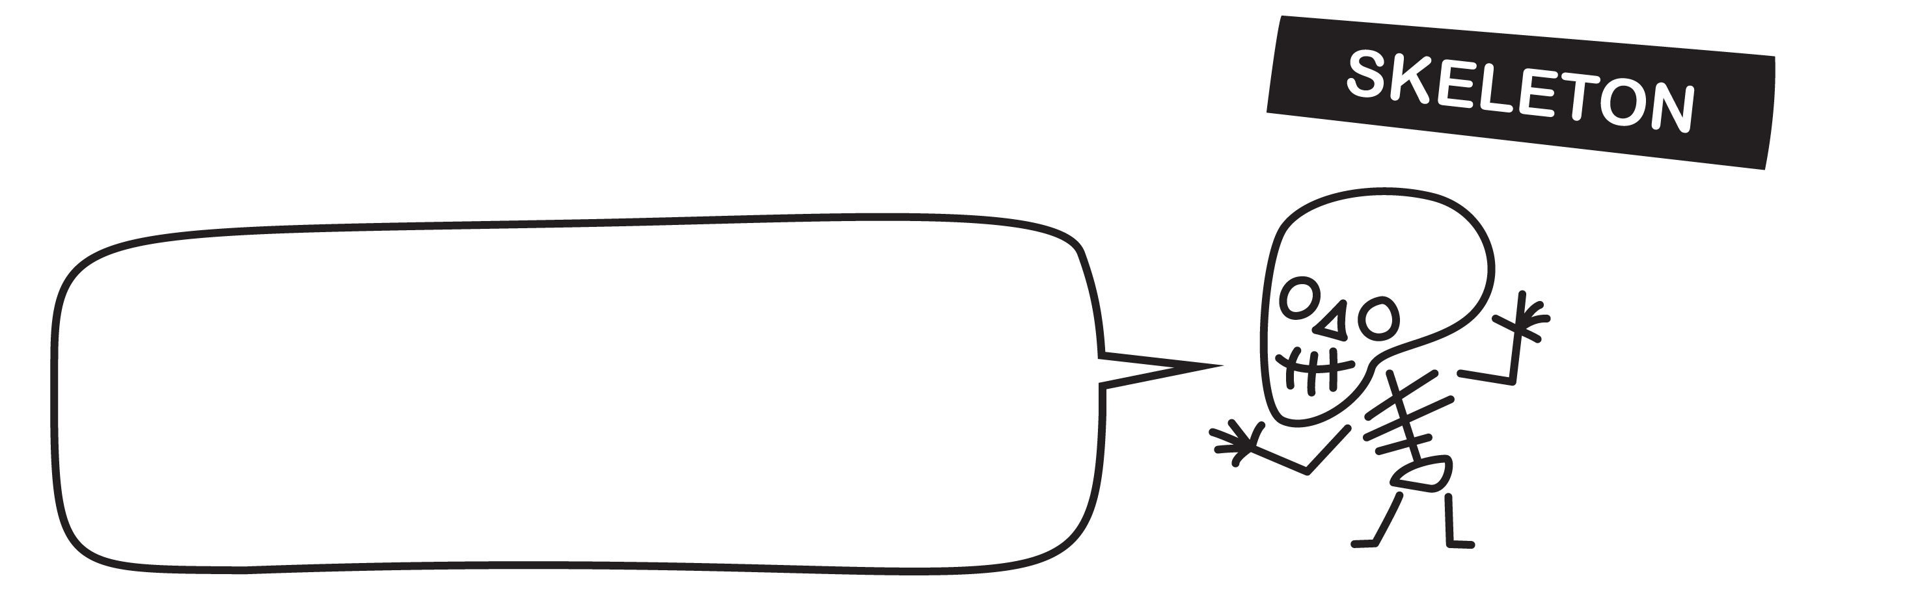


The vampire bat loves baths and hand sanitiser. I saw the clown find a coin in the rubbish bin.

Slide 6
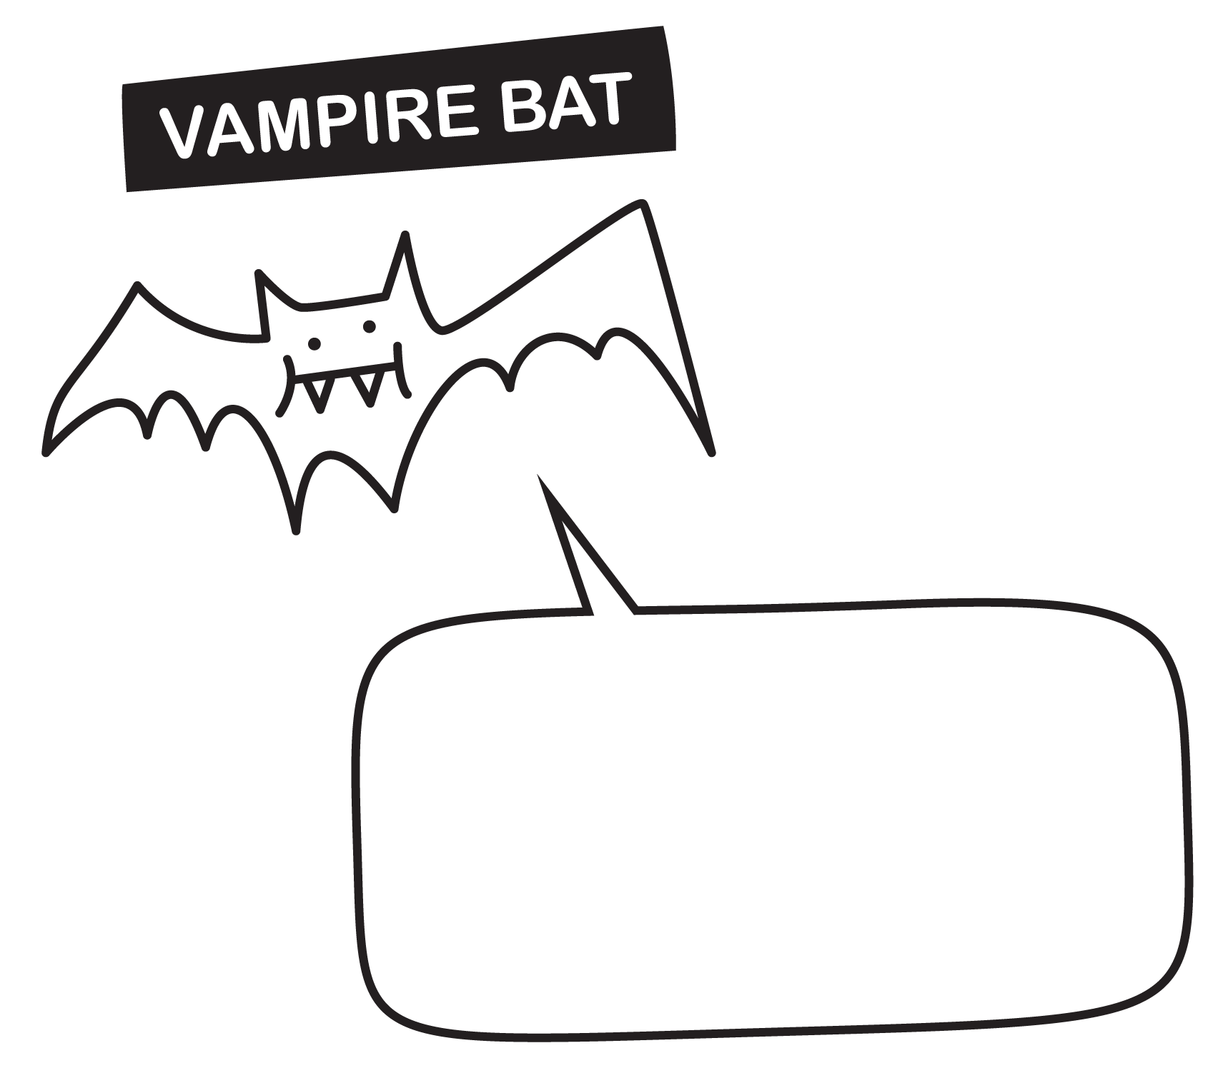

The cat has never been afraid of the skeleton. The cat is afraid of germs.

Slide 7



I would never want to scare the cat. I gave the cat a chocolate coin. The cat is terrified of spiders.

Slide 8


I was terrified!

Slide 9


Fact: The cat and the spider are unaware of each other’s existence.
Fact: Everyone is telling the truth.

Slide 10





Who scared the black cat?
I was terrified!
I find the pumpkin very scary. The vampire bat has never scared anyone ever.
Fact: The cat and the spider are unaware of each other’s existence.
Fact: Everyone is telling the truth.
I tried to scare the cat but I couldn't. The skeleton is scarier than me. We are both scary but are 100% germ-free.
I would never want to scare the cat. I gave the cat a chocolate coin. The cat is terrified of spiders.
The vampire bat loves baths and hand sanitiser. I saw the clown find a coin in the rubbish bin.
The cat has never been afraid of the skeleton. The cat is afraid of germs.

Slide 11


